Slide 1
A phylogenomic investigation of Scutellaria reveals distinct patterns in medicinal flavonoid diversity
Bryce Askey¹, Yeong Hun Song¹, Yoonkyung Lee², Ru Dai¹, Tong Geon Lee^{1,3,4}, Sangtae Kim², and Jeongim Kim^{1,3}
¹Horticultural Sciences Department, University of Florida, Gainesville, FL, USA
²Department of Biology, Sungshin Women’s University, Seoul, Republic of Korea
³Plant Molecular and Cellular Biology Graduate Program, University of Florida, Gainesville, FL, USA
⁴Gulf Coast Research and Education Center, University of Florida, Wimauma, FL, USA

Slide 2
Table S1. Source of Scutellaria tissue samples
 | Species | Condition | Organ | Herbarium | Voucher #
1 | S. alpina | Dried | Leaf, stem | Steere herbarium, NY, USA
2 | S. altissima | Dried | Leaf | Steere herbarium, NY, USA
3 |  | Fresh | Leaf, stem, root
4 | S. angulosa | Dried |  | Steere herbarium, NY, USA
5 | S. angustifolia ssp. angustifolia | Dried |  | Steere herbarium, NY, USA
6 | S. angustifolia ssp. micrathum | Dried |  | Steere herbarium, NY, USA
7 | S. antirrhinoides | Dried |  | Steere herbarium, NY, USA
8 | S. arenicola | Dried |  | UF herbarium, FL, USA
9 |  | Fresh | Leaf, stem, root
10 | S. astinae | Dried | Leaf, stem | Steere herbarium, NY, USA
11 | S. baicalensis | Fresh | Leaf, stem, root
12 | S. barbata | Fresh | Leaf, stem, root
13 |  | Fresh | Leaf, stem, root | KR
14 | S. blepharophylla | Dried |  | Steere herbarium, NY, USA
15 | S. brittonii | Dried |  | Steere herbarium, NY, USA
16 | S. californica | Dried |  | Steere herbarium, NY, USA
17 | S. coccinea | Dried |  | Steere herbarium, NY, USA
18 | S. coerulea | Dried | Leaf | Steere herbarium, NY, USA
19 | S. costaricana | Dried | Leaf, stem | Steere herbarium, NY, USA
20 | S. dependens | Fresh | Leaf, stem, root | KR
21 | S. discolor | Dried |  | Steere herbarium, NY, USA
22 | S. drumondii | Dried |  | Steere herbarium, NY, USA
23 | S. elliptica | Dried |  | UF herbarium, FL, USA
24 | S. epilobiifolia | Dried | Leaf, stem | Steere herbarium, NY, USA
25 | S. formosa | Dried | Leaf, stem | Steere herbarium, NY, USA
26 | S. fructicosa | Dried | Leaf | Steere herbarium, NY, USA
27 | S. galericulata | Dried | Leaf, stem | Steere herbarium, NY, USA
28 | S. glabriuscula | Dried |  | Steere herbarium, NY, USA
29 | S. guatemalensis | Dried |  | Steere herbarium, NY, USA
30 | S. hastifolia | Fresh | Leaf, stem, root
31 | S. havanensis | Dried |  | Steere herbarium, NY, USA
32 |  | Fresh | Leaf, stem, root
33 | S. heterophylla | Dried |  | Steere herbarium, NY, USA
34 | S. heydei | Dried |  | Steere herbarium, NY, USA
35 | S. hispidula | Dried |  | Steere herbarium, NY, USA
36 | S. holmgreniorum | Dried | Leaf, stem | Steere herbarium, NY, USA
37 | S. hookeri | Dried | Leaf, stem | Steere herbarium, NY, USA
38 | S. incanca | Dried |  | Steere herbarium, NY, USA
39 | S. indica var. coccinea | Fresh | Leaf, stem, root | KR
40 | S. insignis | Fresh | Leaf, stem, root | KR
41 | S. integrifolia | Dried |  | UF herbarium, FL, USA
42 | S. isochelia | Dried | Leaf, stem | Steere herbarium, NY, USA
43 | S. javalambrensis | Dried |  | Steere herbarium, NY, USA
44 | S. javanica | Dried |  | Steere herbarium, NY, USA
45 | S. lateriflora | Dried | Leaf | Steere herbarium, NY, USA
46 |  | Fresh | Leaf, stem, root
47 | S. leonardii | Dried |  | Steere herbarium, NY, USA
48 |  | Fresh | Leaf, stem, root
49 | S. leptosiplonsipkon | Dried |  | Steere herbarium, NY, USA
50 | S. longifolia | Dried | Leaf, stem | Steere herbarium, NY, USA

Slide 3
Table S1 cont. Source of Scutellaria tissue samples
 | Species | Condition | Organ | Herbarium | Voucher #
51 | S. lutea | Dried |  | Steere herbarium, NY, USA
52 | S. lutilaba | Dried | Leaf, stem | Steere herbarium, NY, USA
53 | S. microphylla | Dried | Leaf, stem, root | Steere herbarium, NY, USA
54 | S. multicularis | Dried |  | Steere herbarium, NY, USA
55 | S. multiglandulosa | Dried |  | Steere herbarium, NY, USA
56 | S. multiglandulosa | Dried |  | UF herbarium, FL, USA
57 | S. muriculata | Dried |  | Steere herbarium, NY, USA
58 | S. oblonga | Dried |  | Steere herbarium, NY, USA
59 | S. orientalis | Dried | Leaf, stem | Steere herbarium, NY, USA
60 | S. ovata | Dried | Leaf | Steere herbarium, NY, USA
61 | S. parvula | Dried | Leaf, stem | Steere herbarium, NY, USA
62 | S. paucifolia | Dried |  | Steere herbarium, NY, USA
63 | S. pekenensis var. alpina | Fresh | Leaf, stem, root | KR
64 | S. peregrina | Dried |  | Steere herbarium, NY, USA
65 | S. pinnatifida | Dried |  | Steere herbarium, NY, USA
66 | S. potosina | Dried | Leaf, stem | Steere herbarium, NY, USA
67 | S. prostrata | Dried |  | Steere herbarium, NY, USA
68 | S. przewalskii | Dried |  | Steere herbarium, NY, USA
69 | S. pseudoserrata | Dried |  | Steere herbarium, NY, USA
70 | S. pulchella | Dried | Root | Steere herbarium, NY, USA
71 | S. purpurascens | Dried |  | Steere herbarium, NY, USA
72 | S. racemosa | Dried |  | UF herbarium, FL, USA
73 |  | Fresh | Leaf, stem, root
74 | S. relenorskyi | Dried |  | Steere herbarium, NY, USA
75 | S. resinosa | Dried | Leaf, stem | Steere herbarium, NY, USA
76 | S. sapphirina | Dried | Leaf, stem | Steere herbarium, NY, USA
77 | S. scordiifolia | Dried |  | Steere herbarium, NY, USA
78 | S. seleriana | Dried |  | Steere herbarium, NY, USA
79 | S. serrata | Dried | Leaf | Steere herbarium, NY, USA
80 | S. siphocampuloides | Dried | Leaf, stem | Steere herbarium, NY, USA
81 | S. splendens | Dried | Leaf | Steere herbarium, NY, USA
82 | S. strigillosa | Fresh | Leaf, stem, root | KR
83 | S. suffrutscens | Dried |  | Steere herbarium, NY, USA
84 | S. sumatrana | Dried |  | Steere herbarium, NY, USA
85 | S. tessellata | Dried | Leaf, stem | Steere herbarium, NY, USA
86 | S. tournefortii | Fresh | Leaf, stem, root

Slide 4
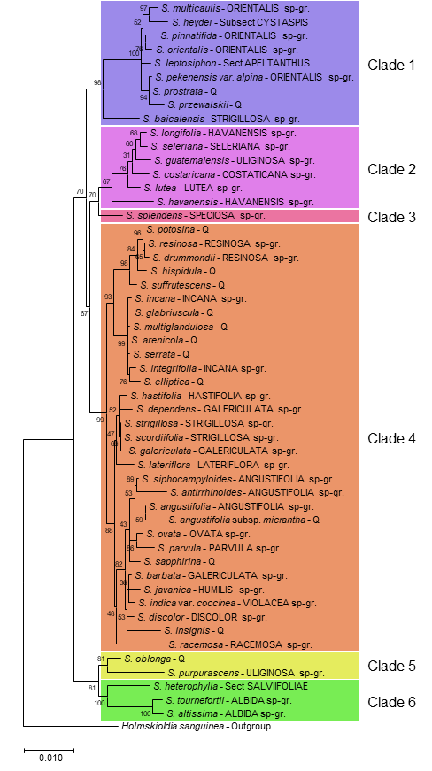
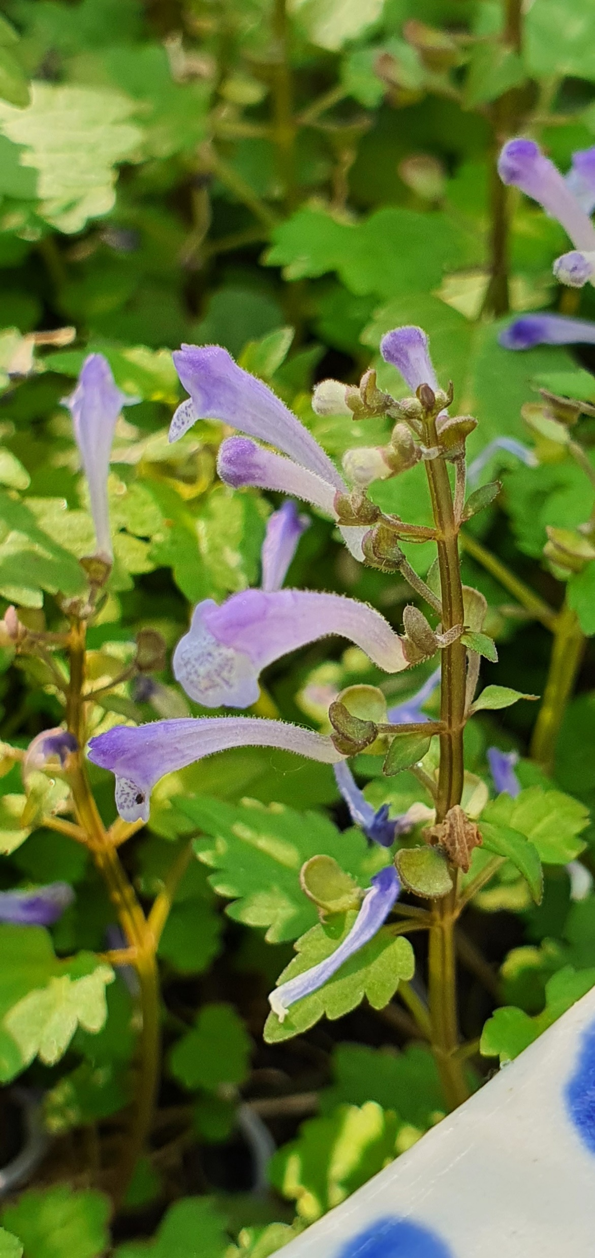
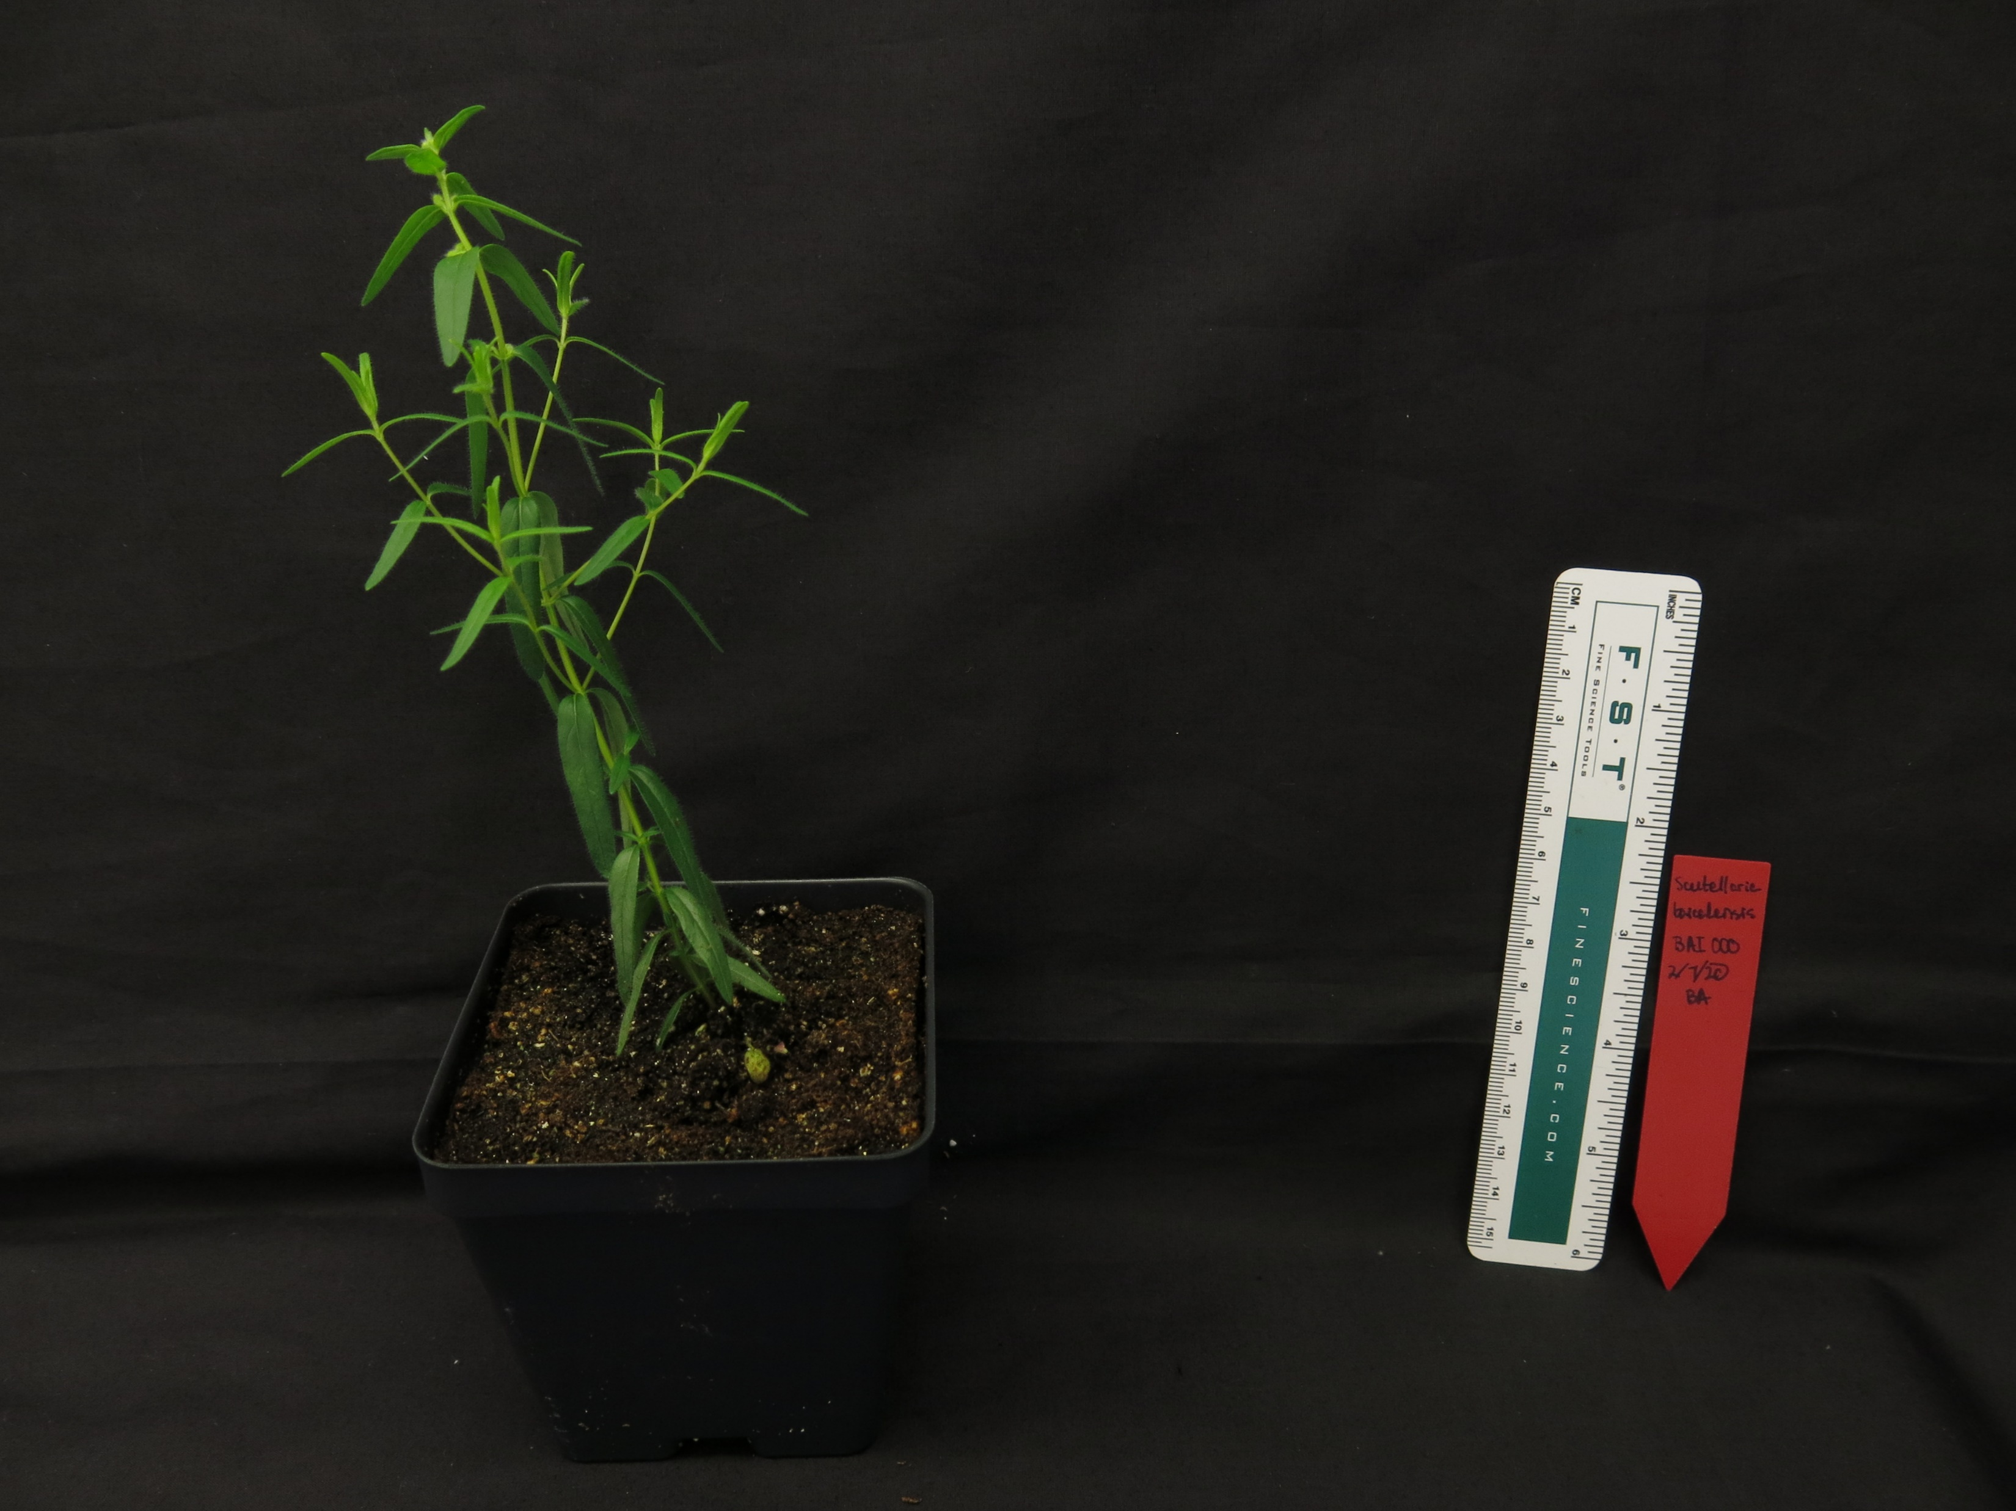
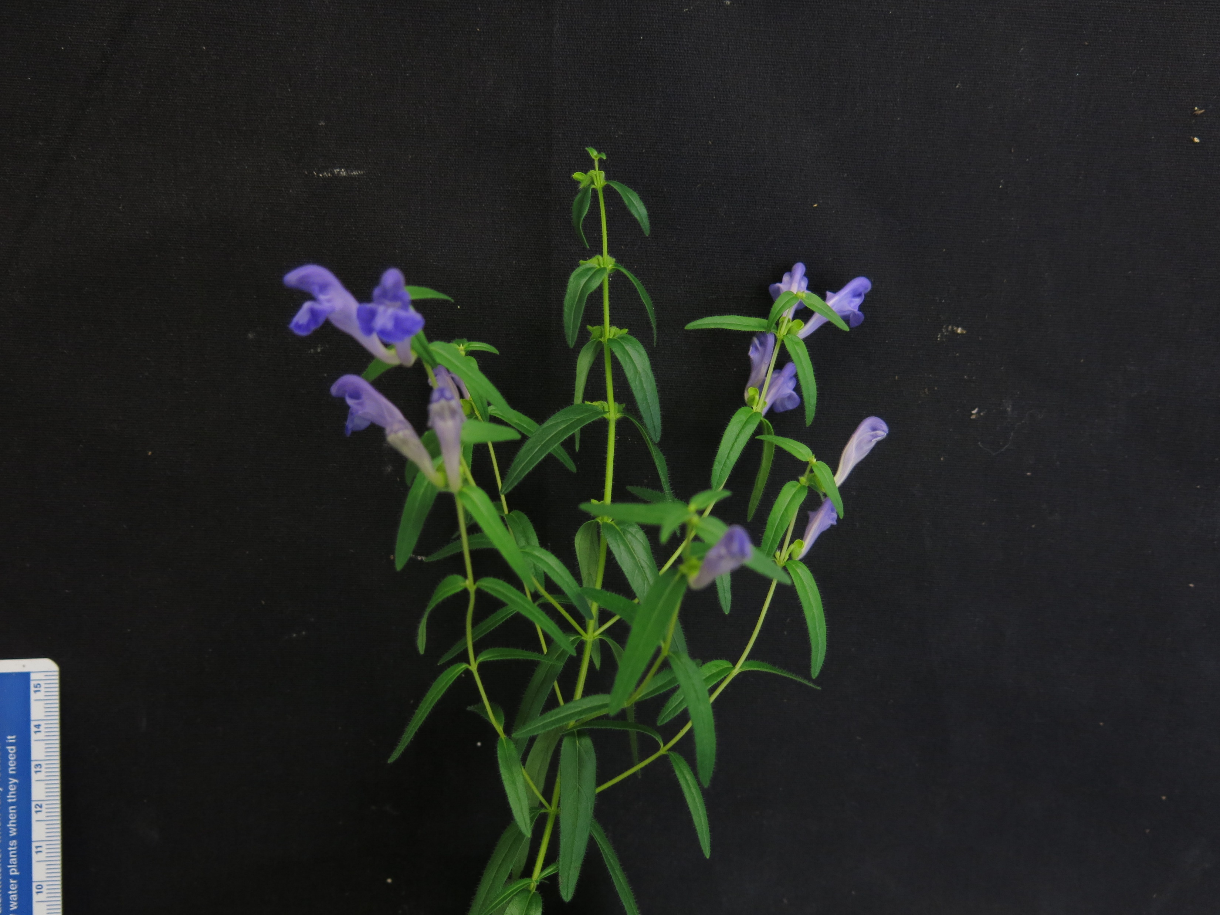
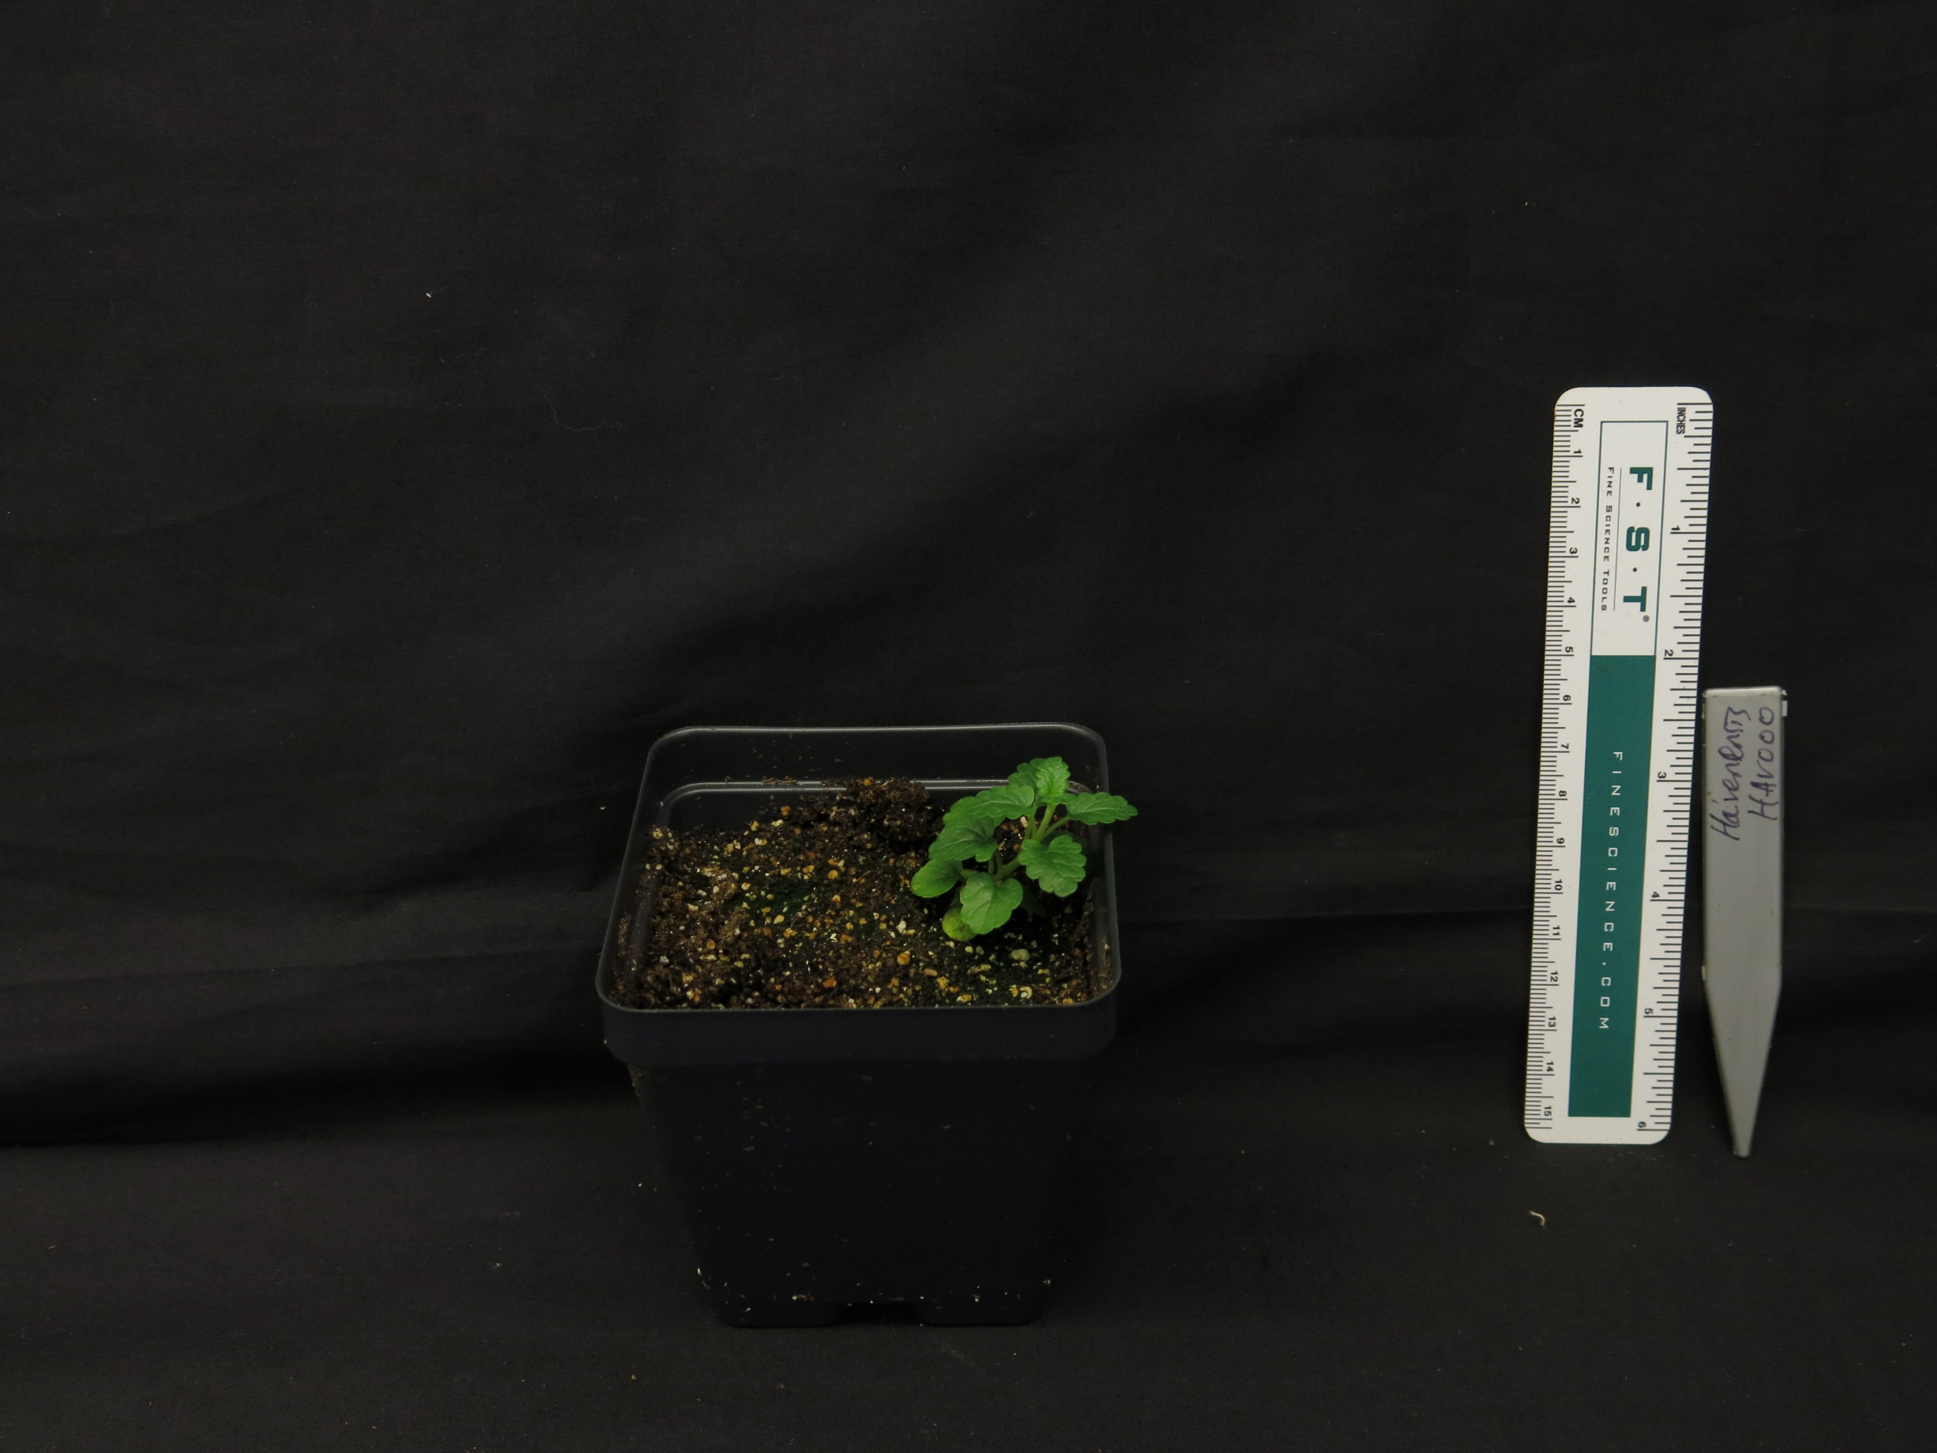
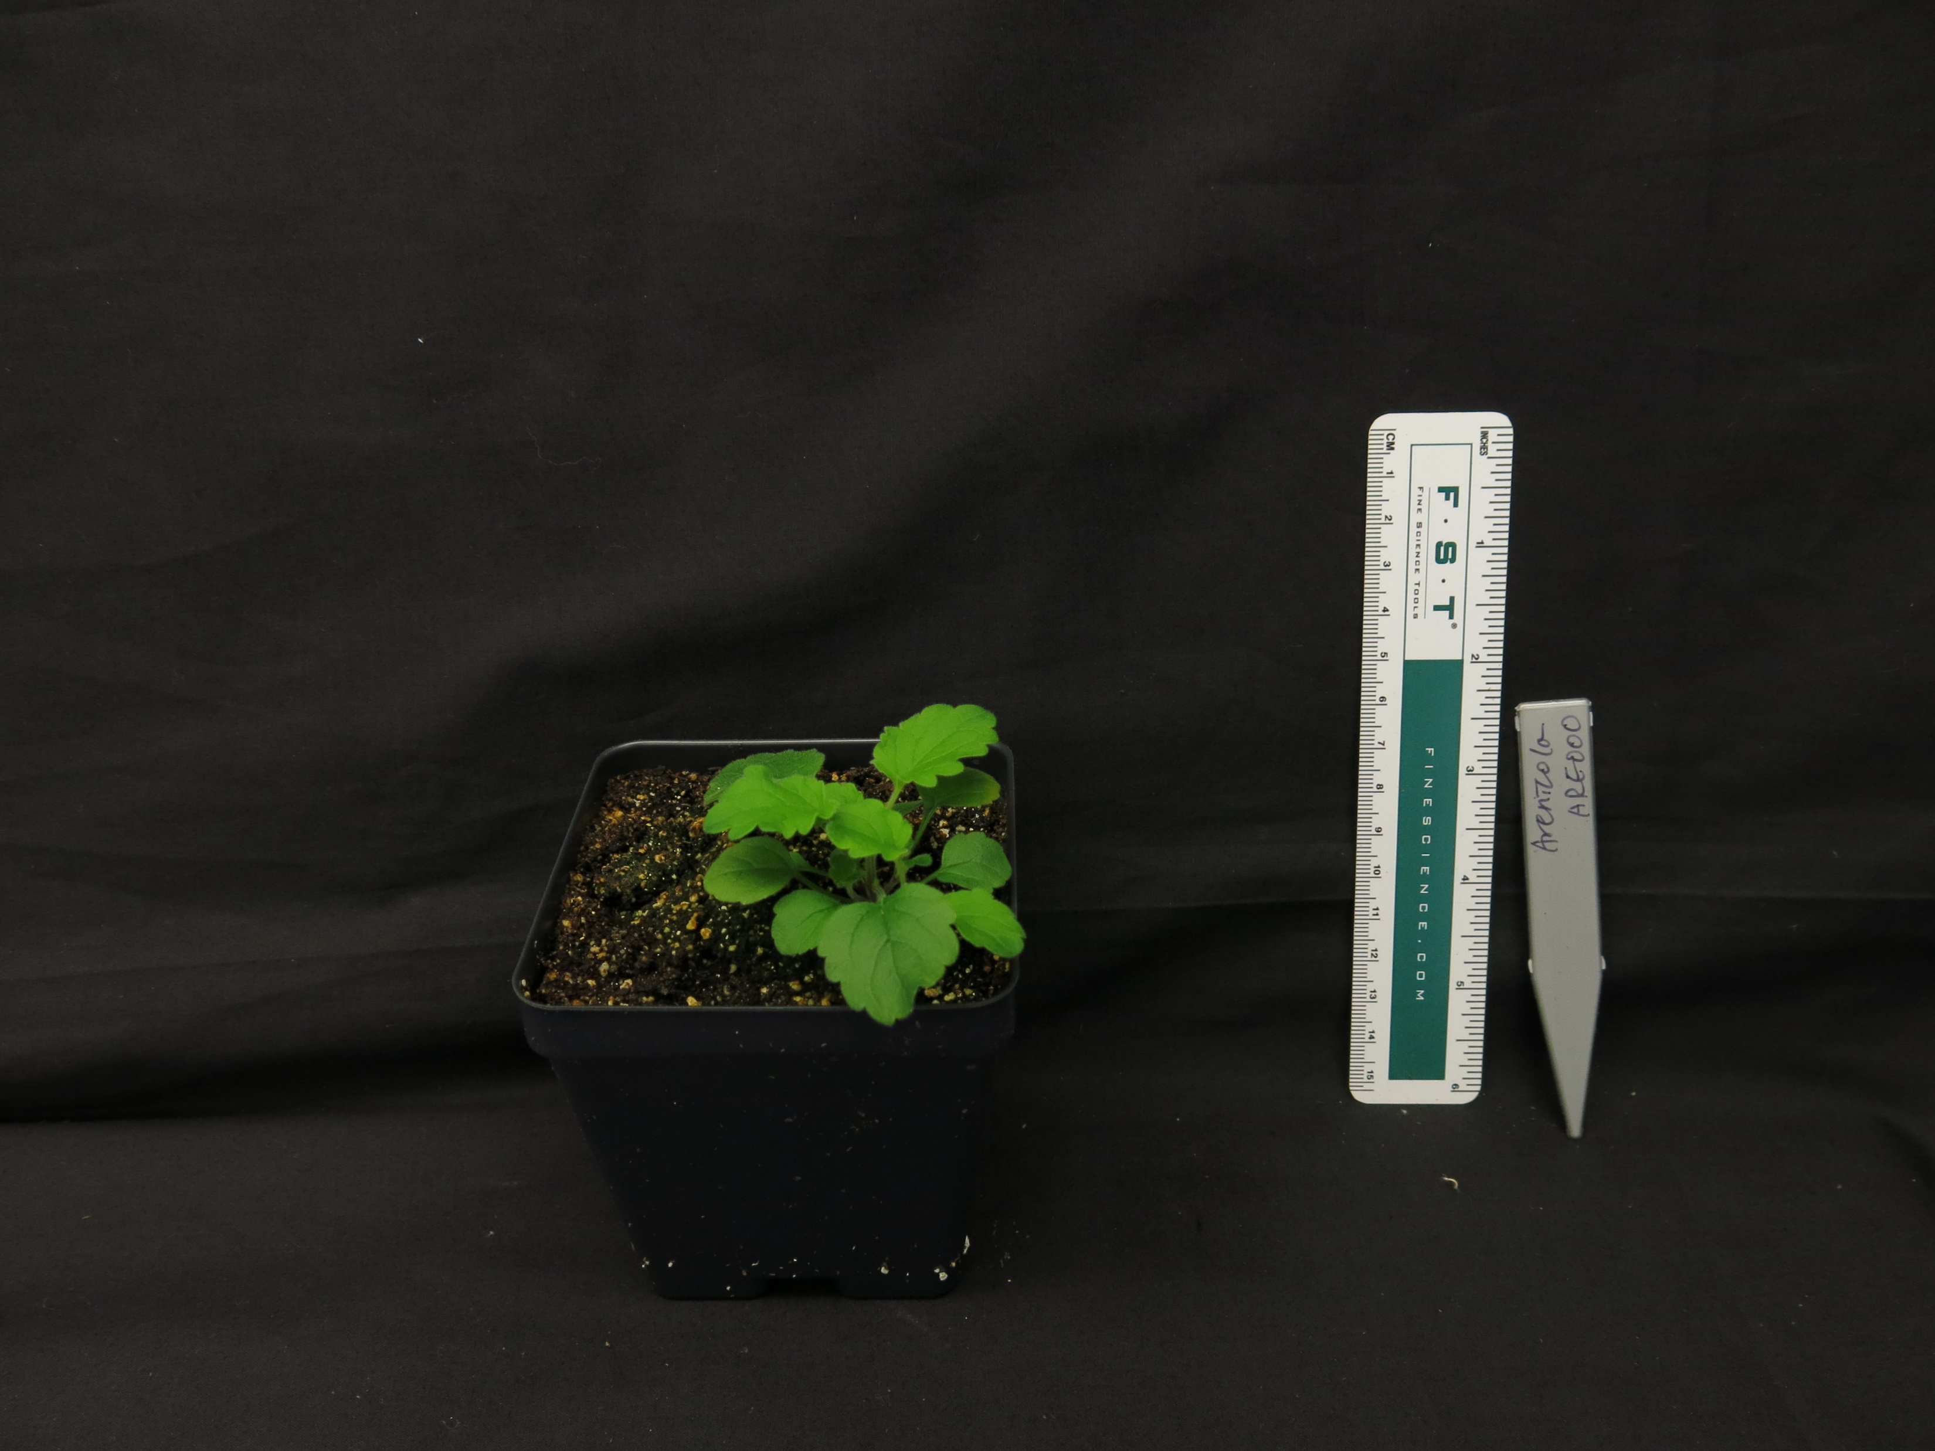
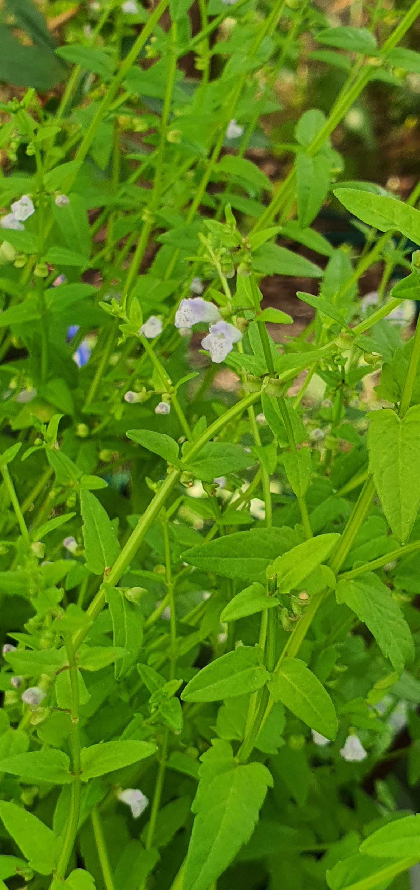
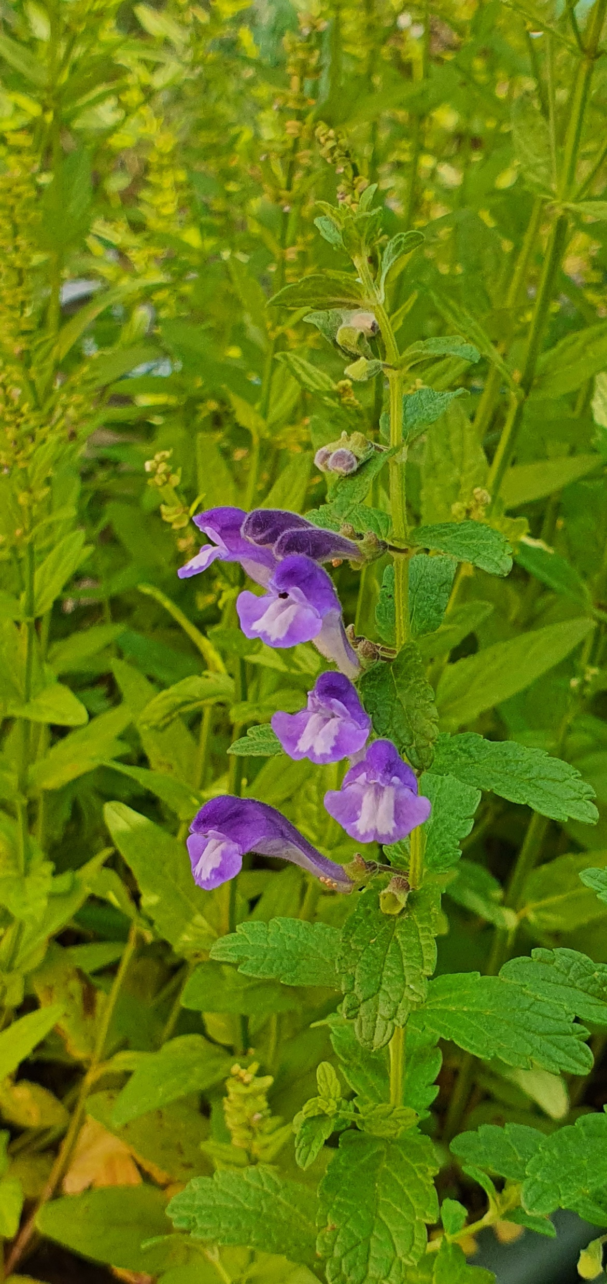
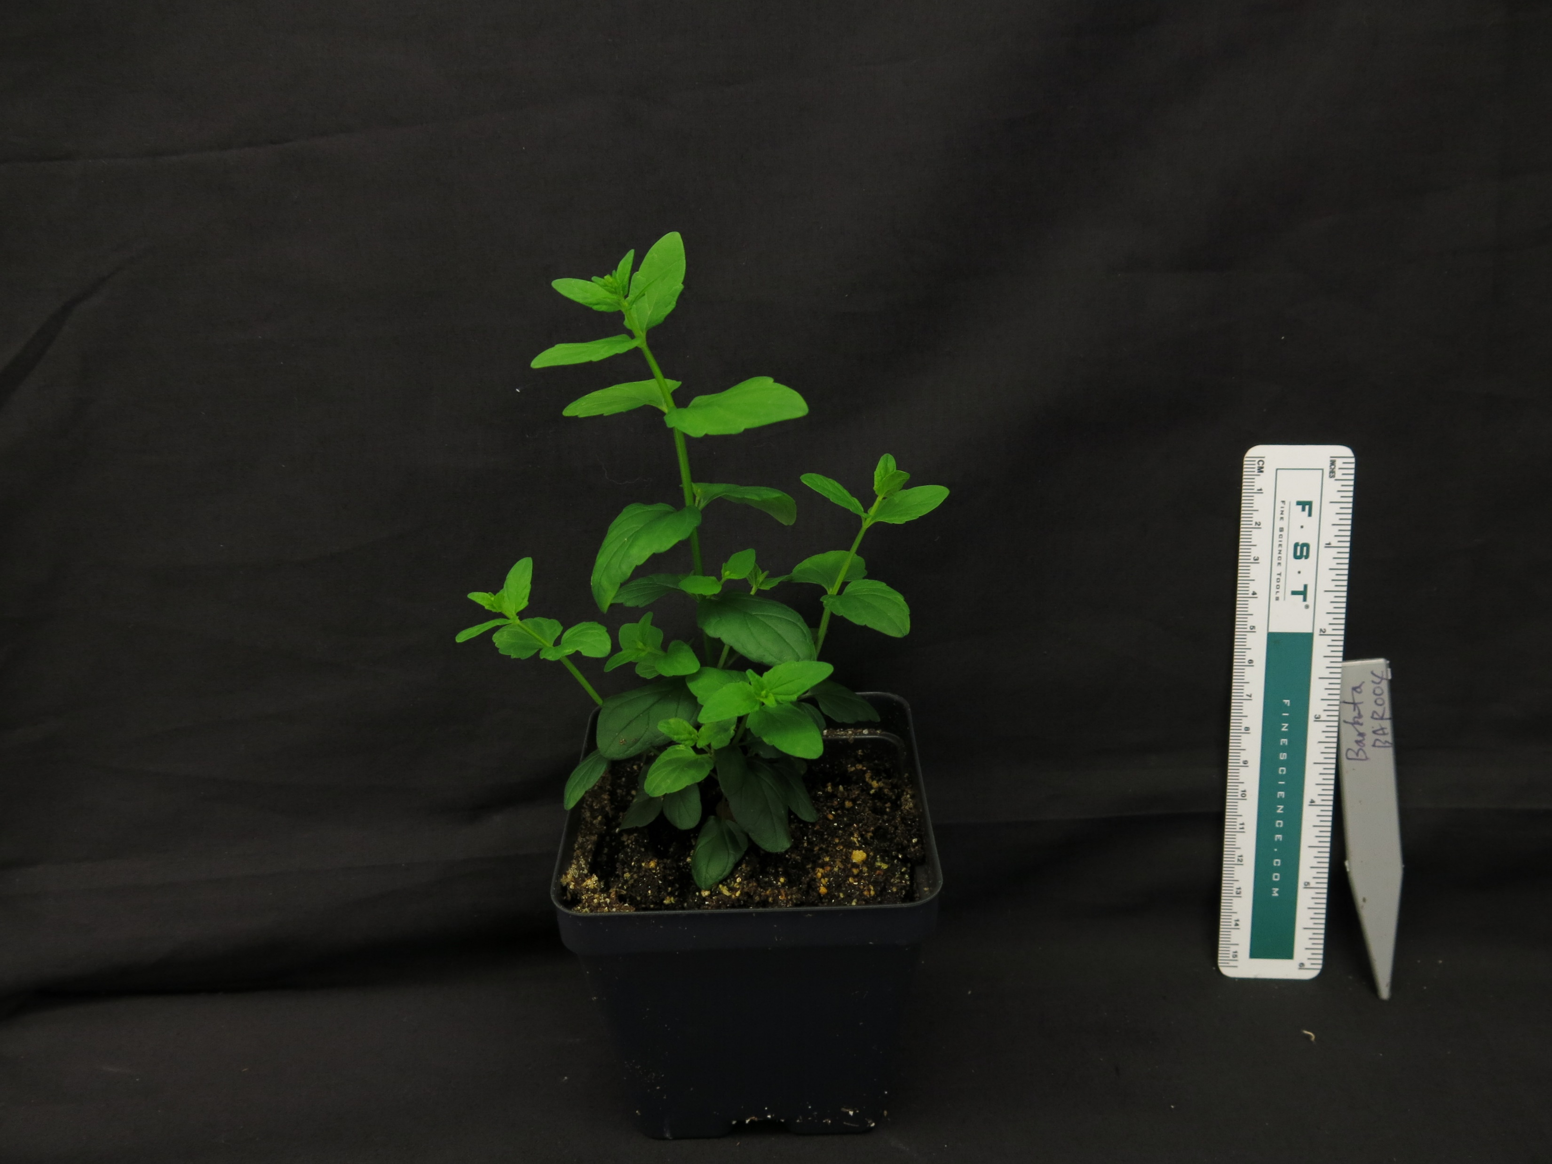
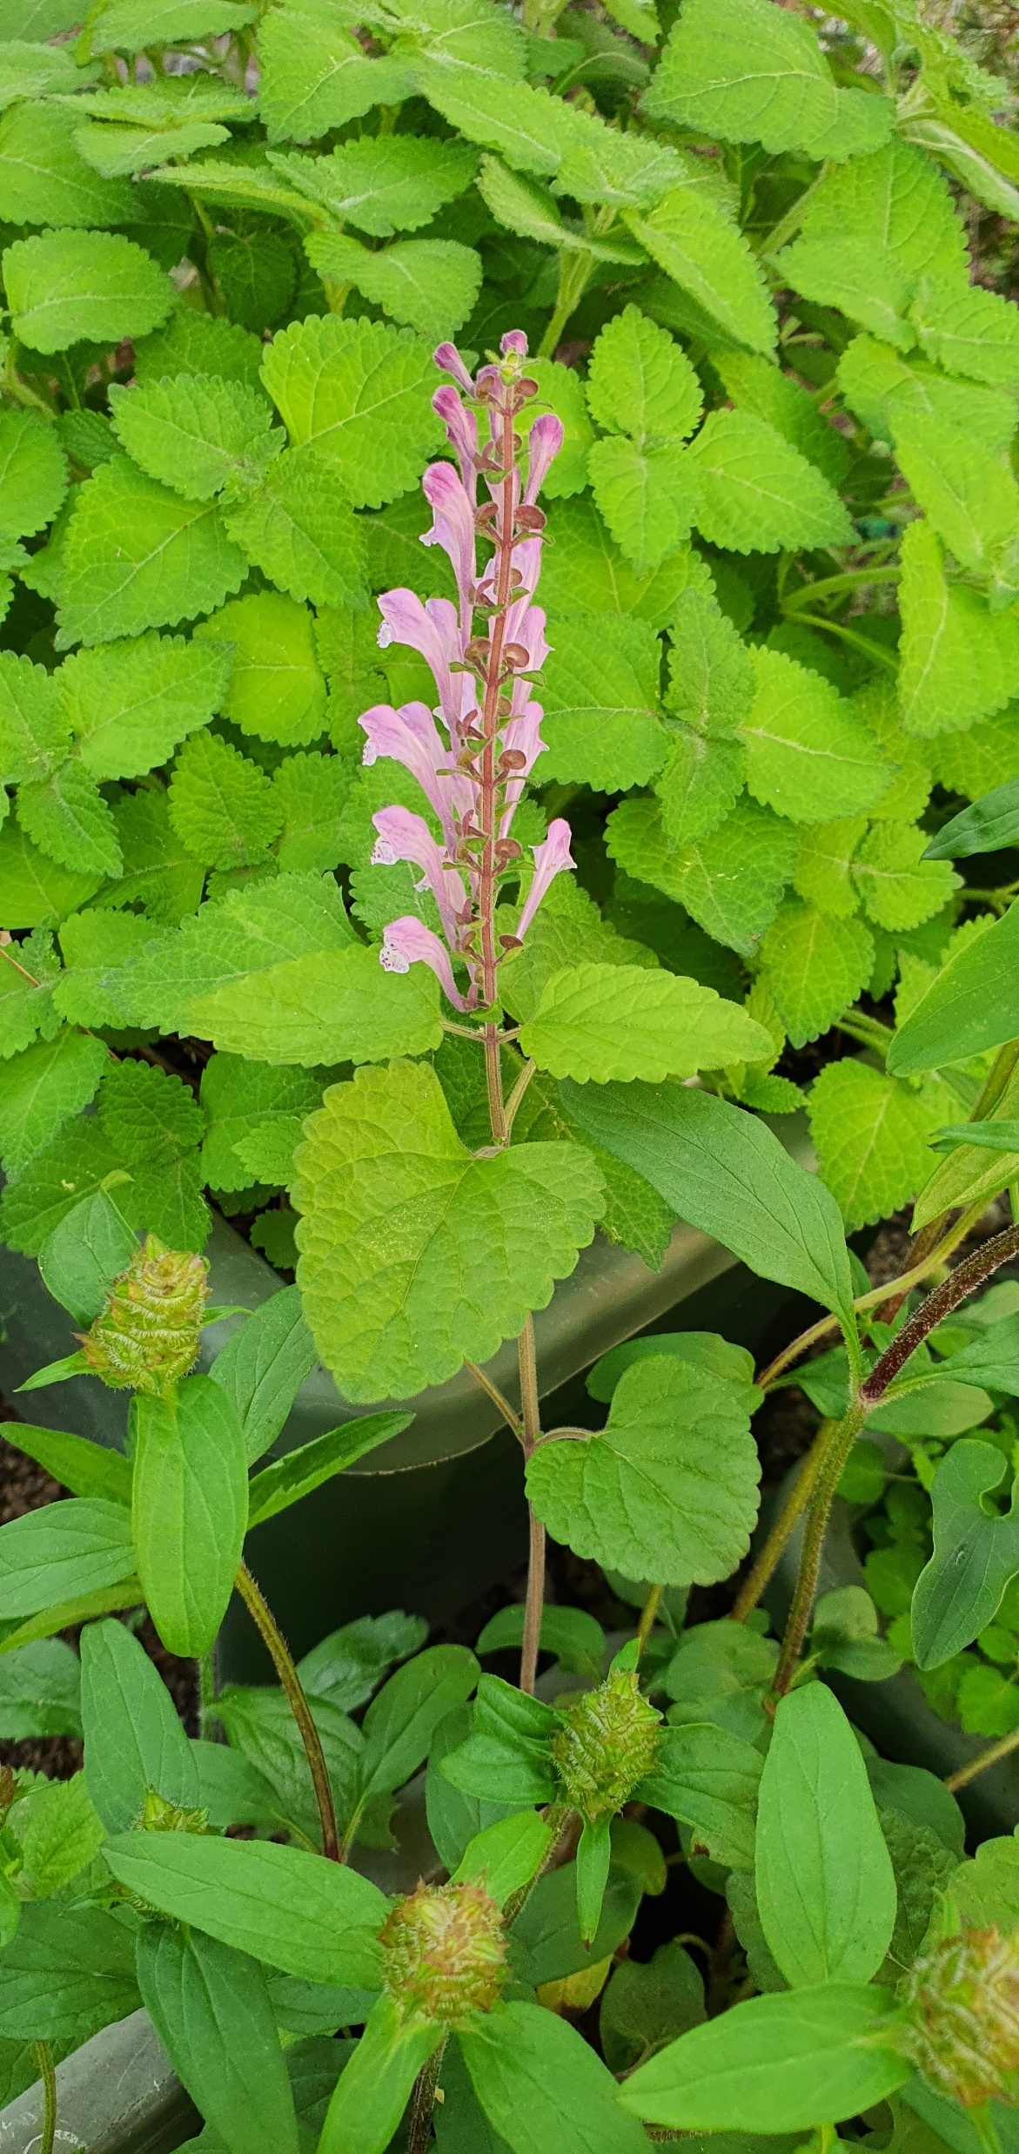
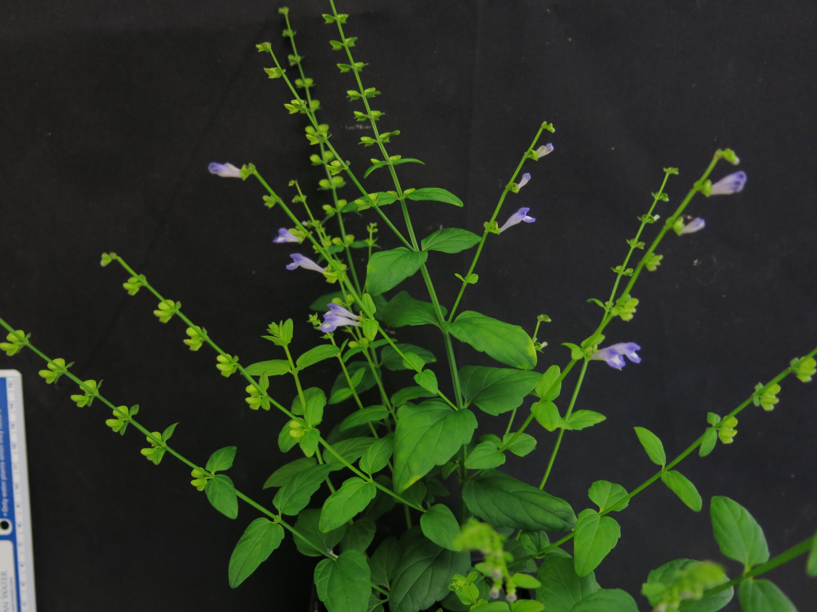
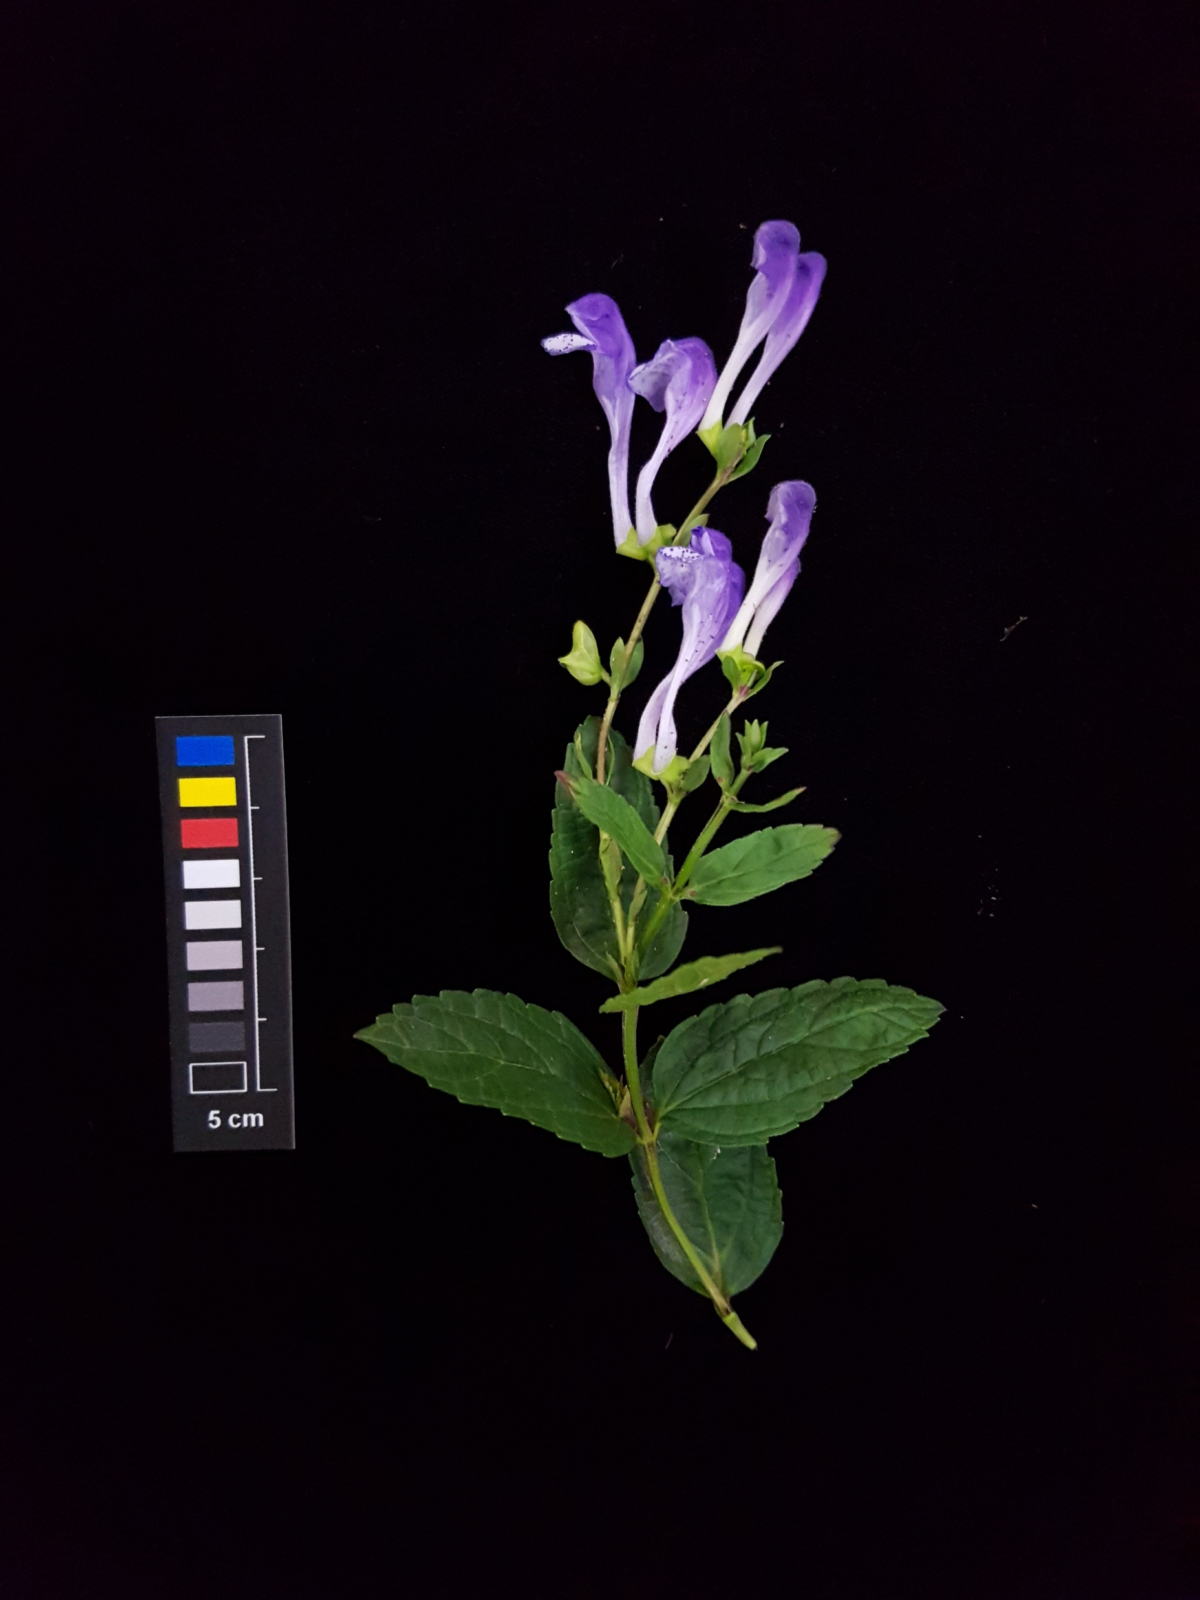
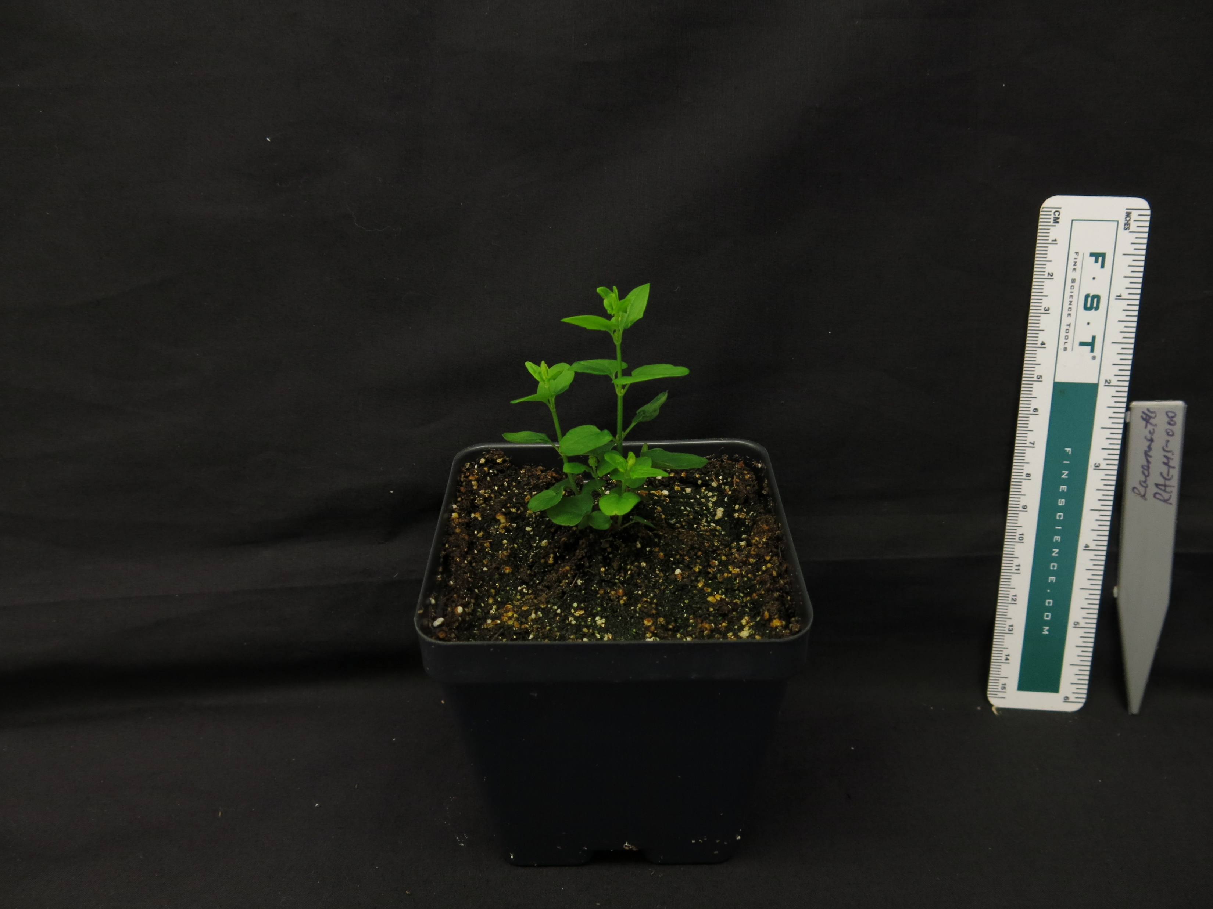
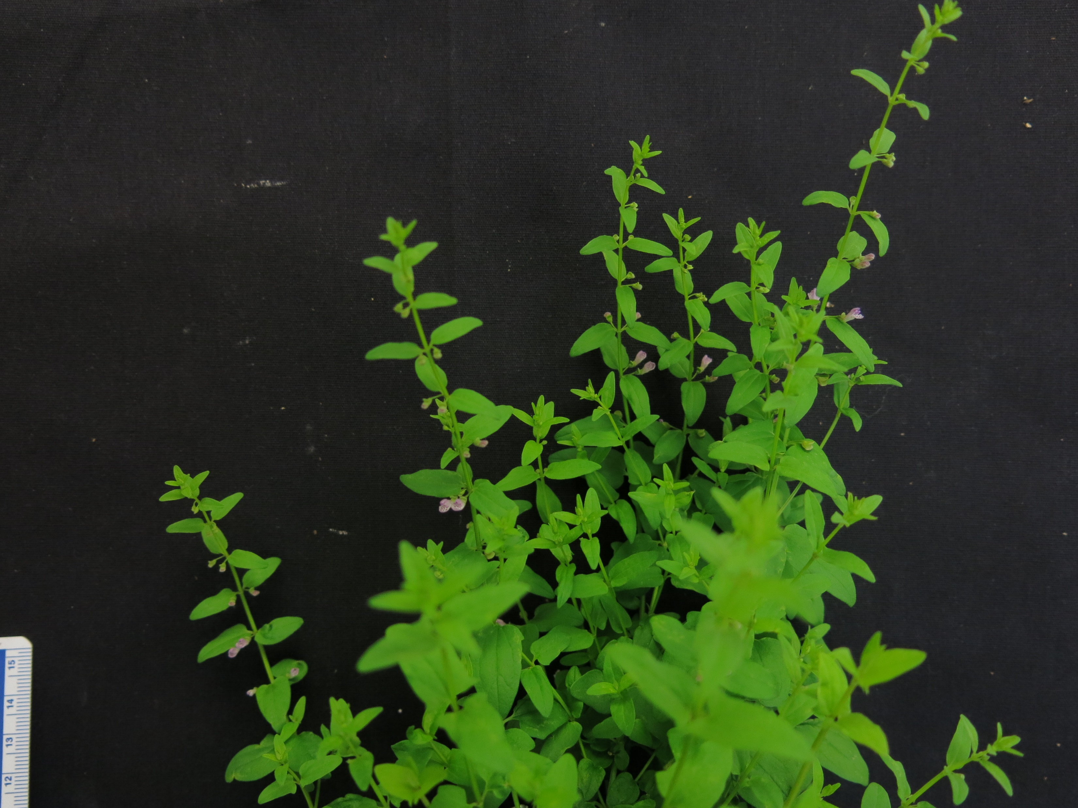
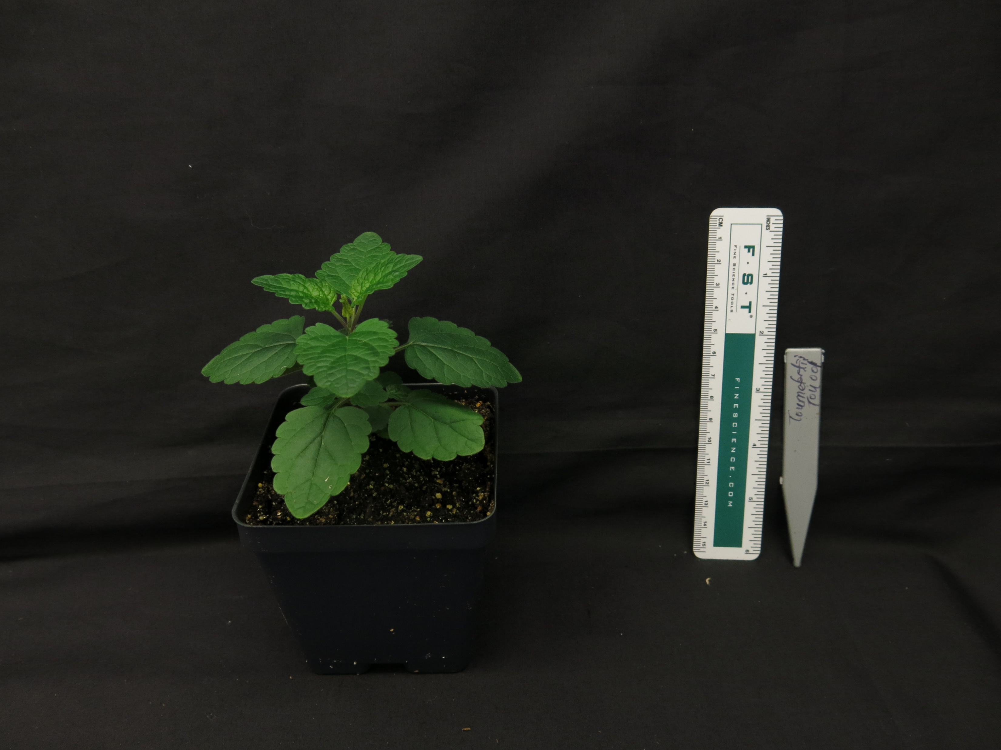
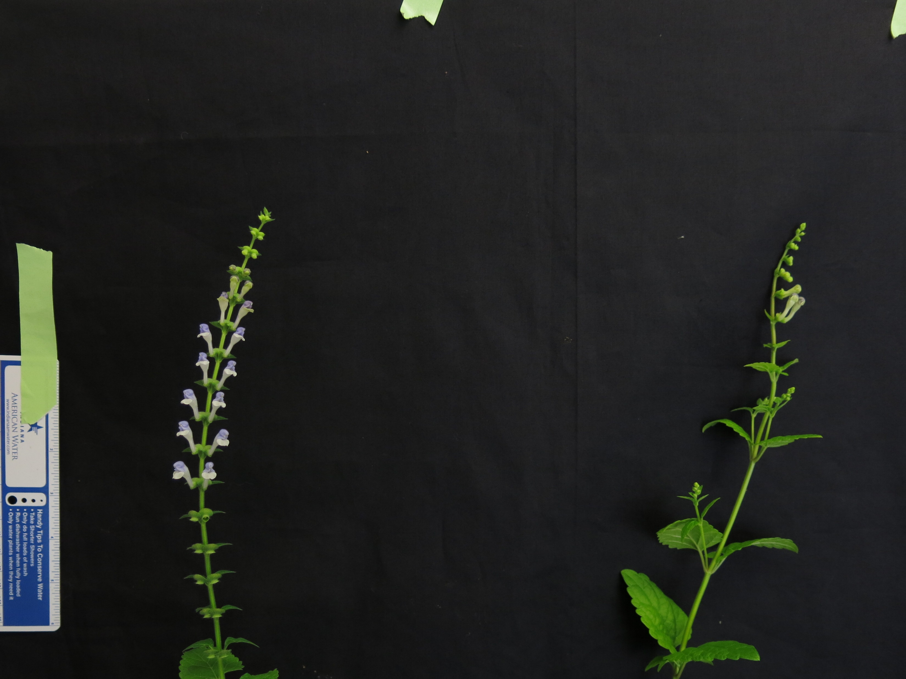
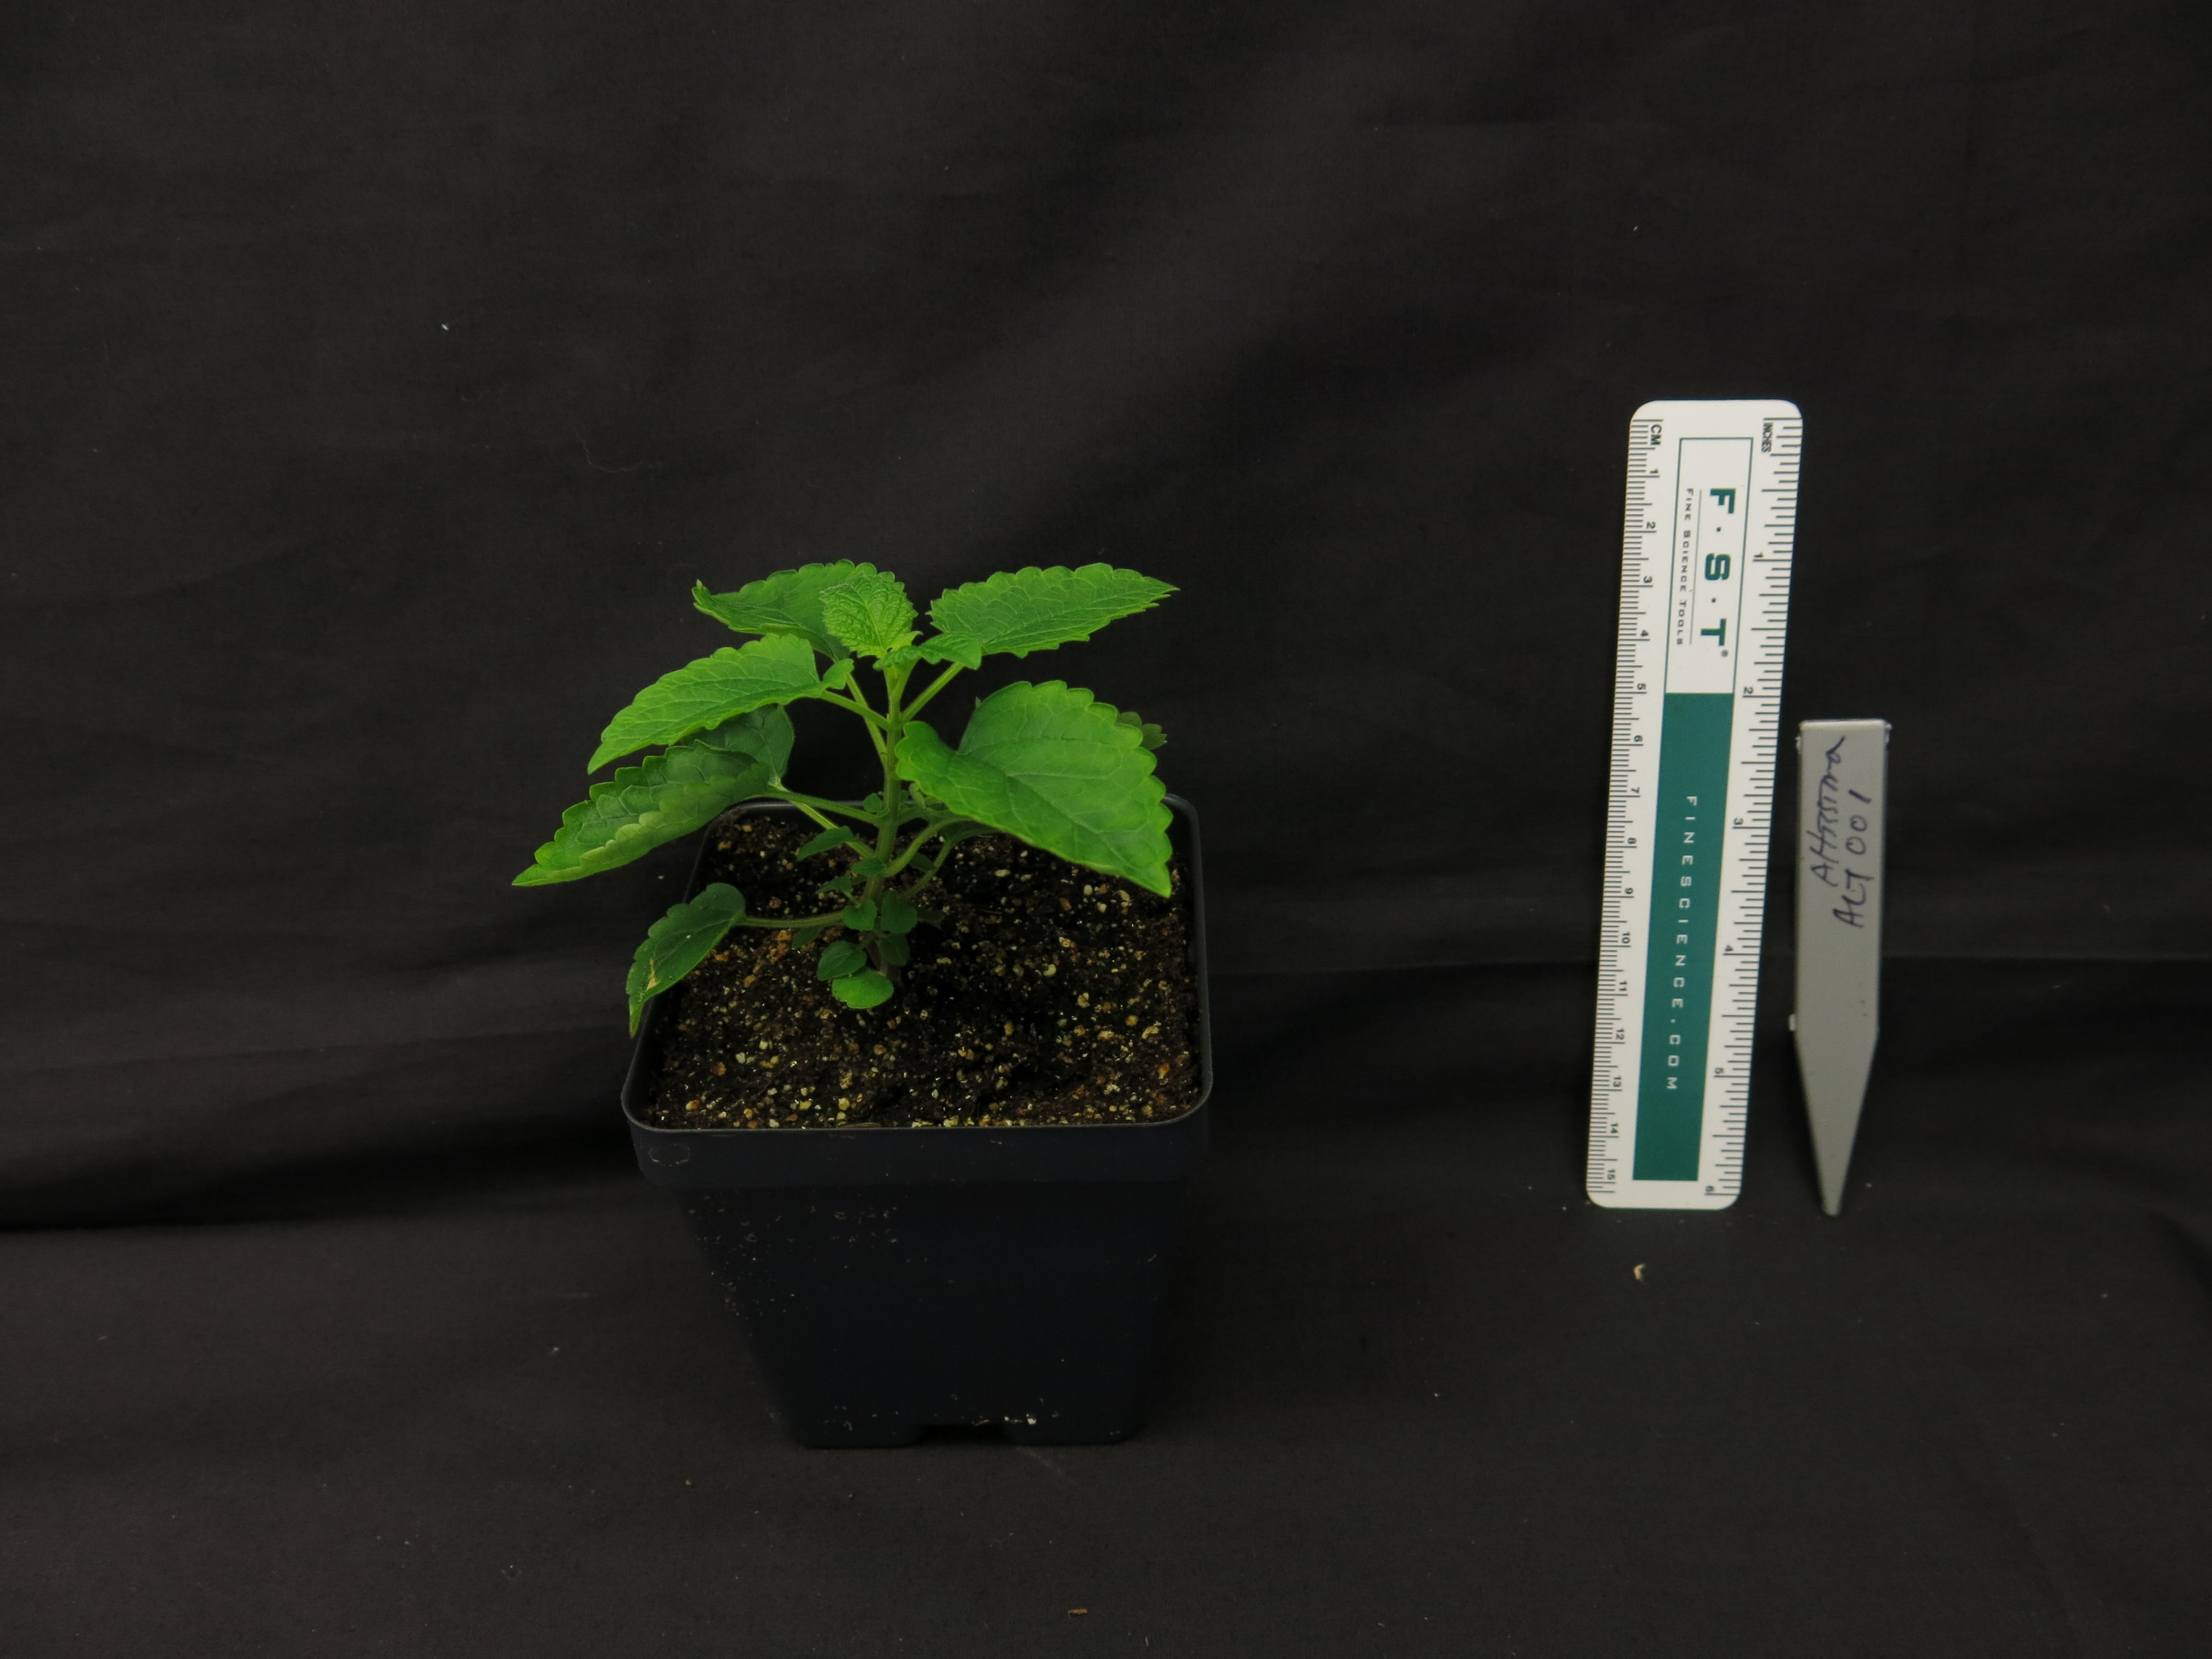
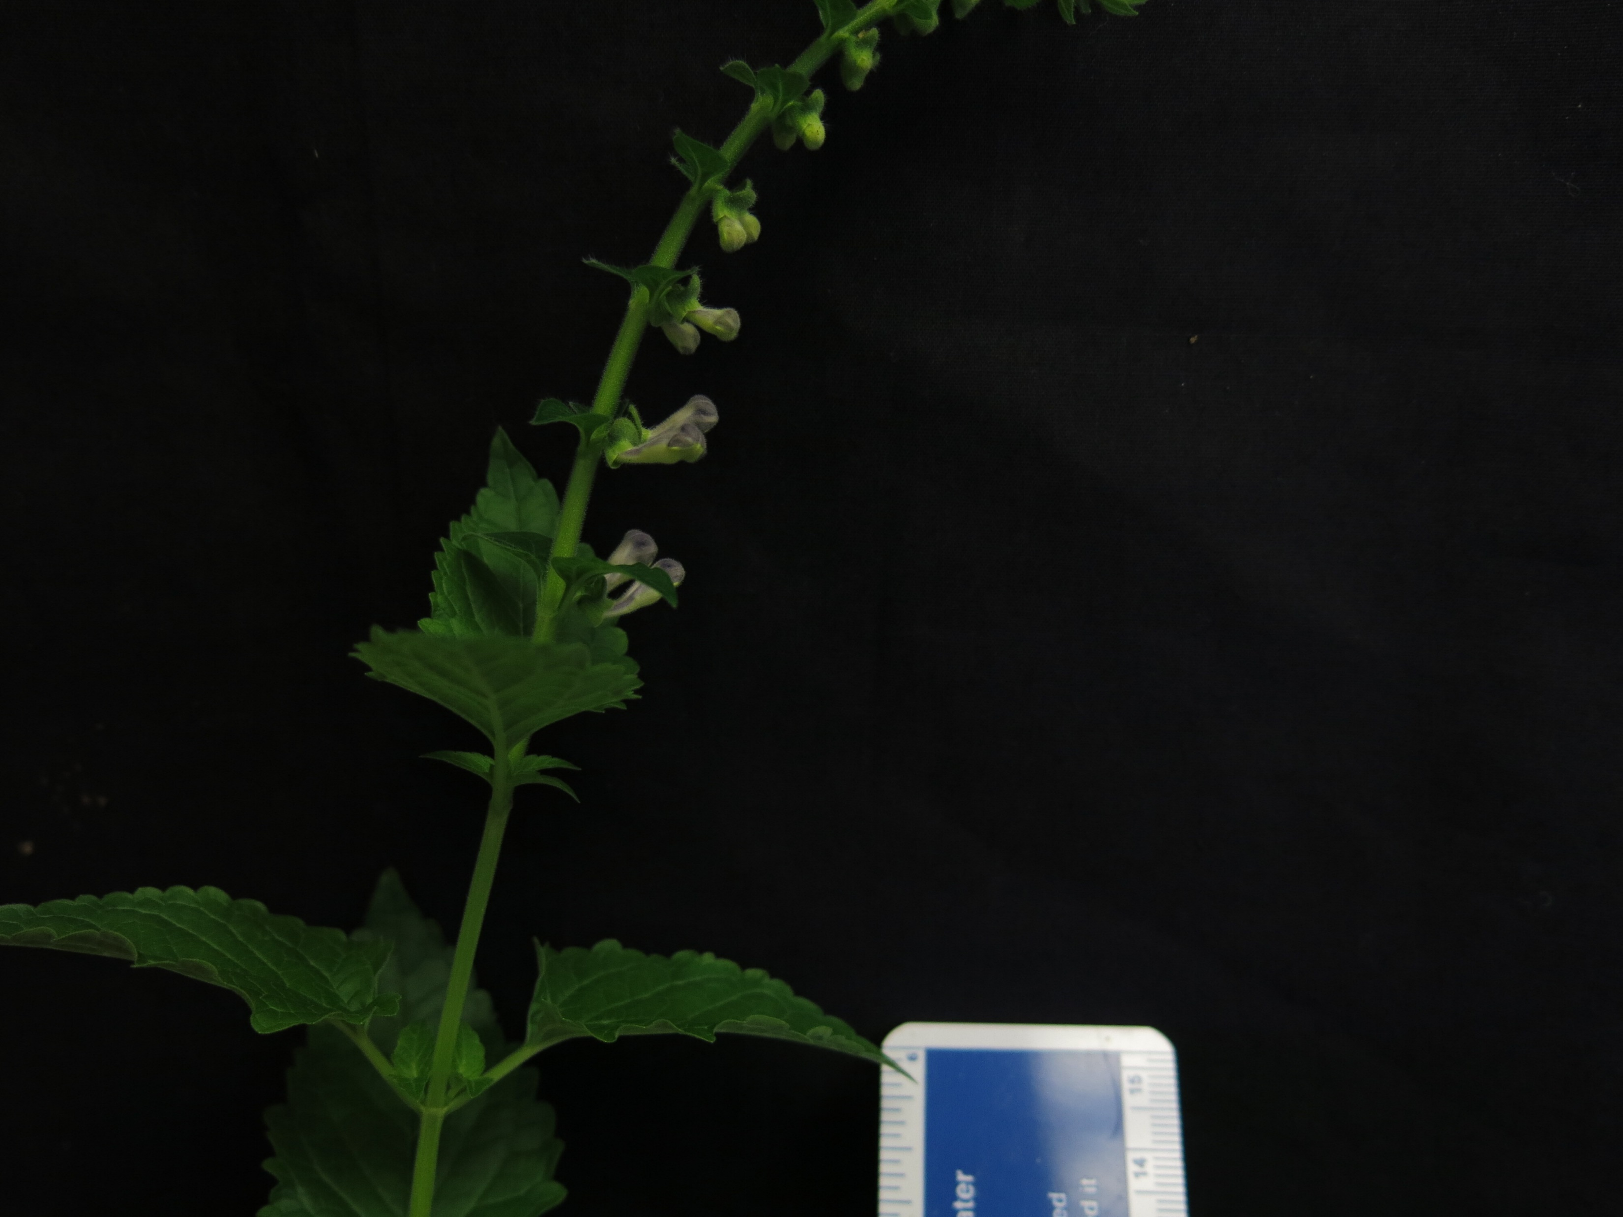
A.
B.
S. pekenensis var. alpina
S. baicalensis
S. havanensis
S. arenicola
S. dependens
S. strigillosa
S. barbata
S. indica var. coccinea
S. insignis
S. racemosa
S. tournefortii
S. altissima
Figure 1. (A) Maximum likelihood tree inferred from chloroplast genome data for 52 species of Scutellaria. To facilitate downstream analysis, the tree is subdivided into 6 clades. (B) Representative images of 12 species of Scutellaria. Scale bar in bottom left of images represents a length of 5 cm. Images without a scale bar didn’t have a ruler included in the image. Colored circles next to species names indicate the clade which the species belongs to.

Slide 5
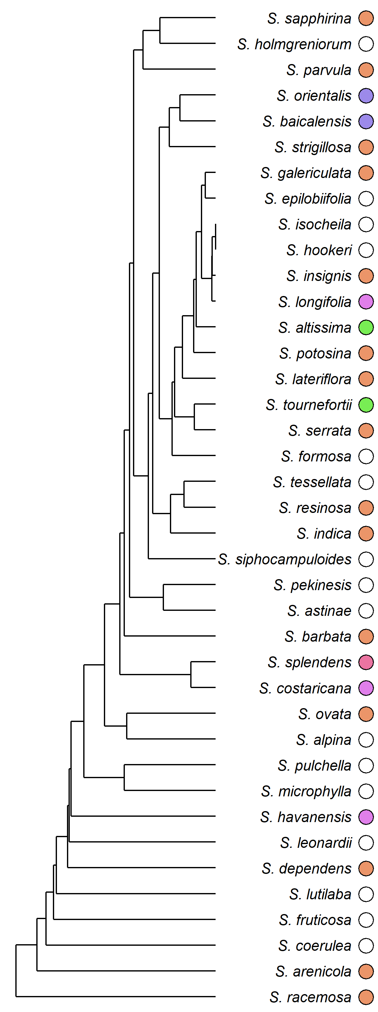
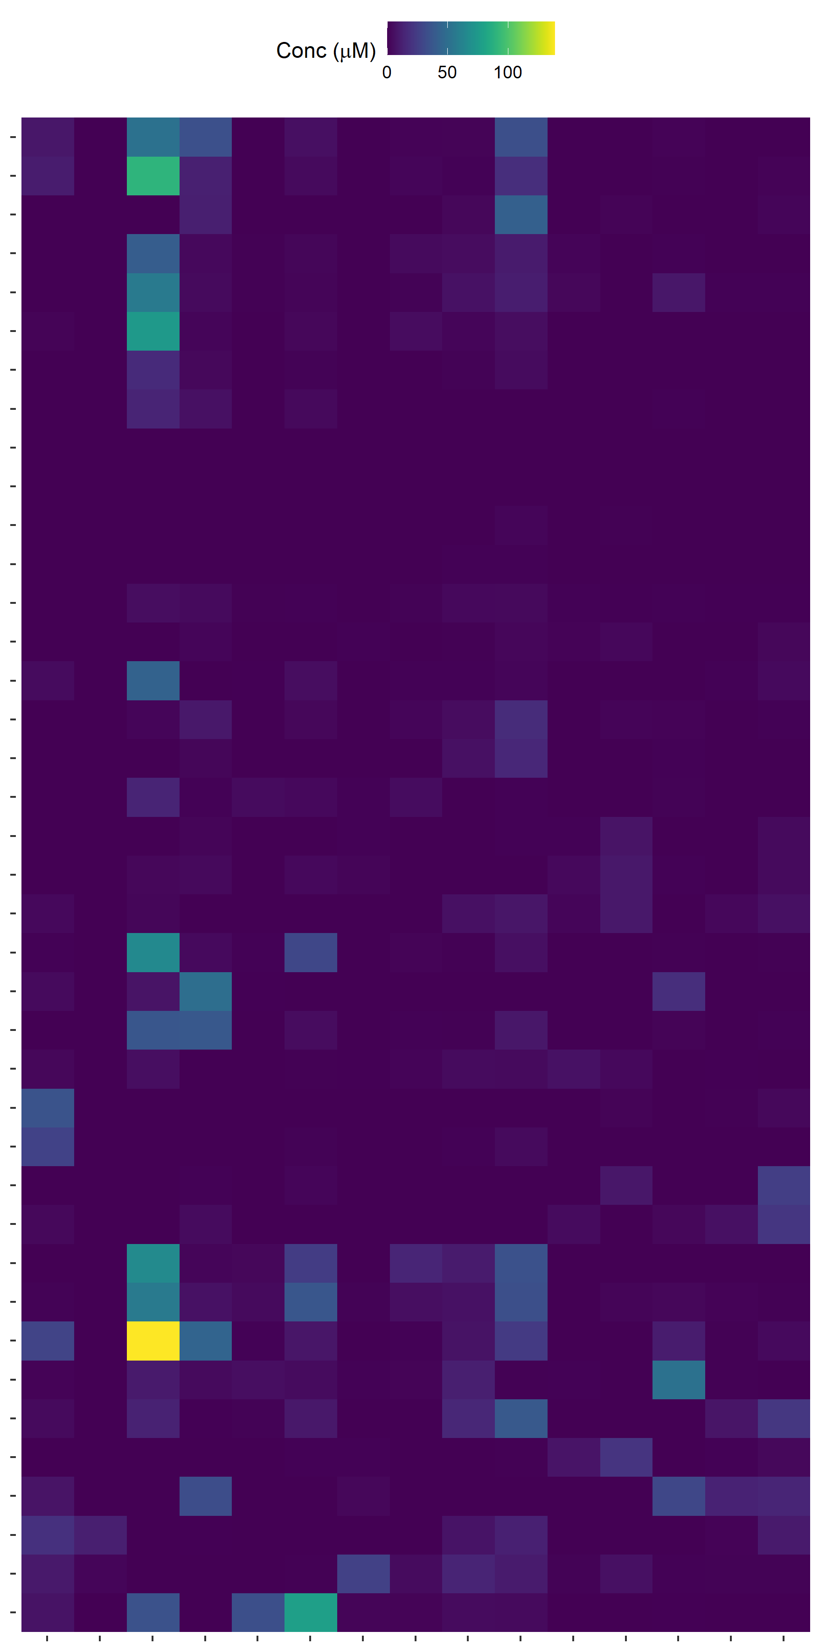
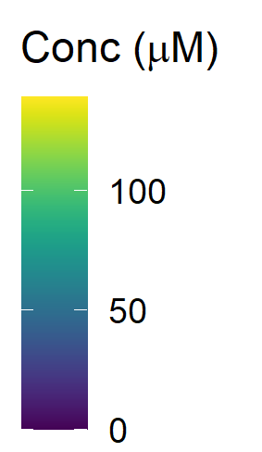
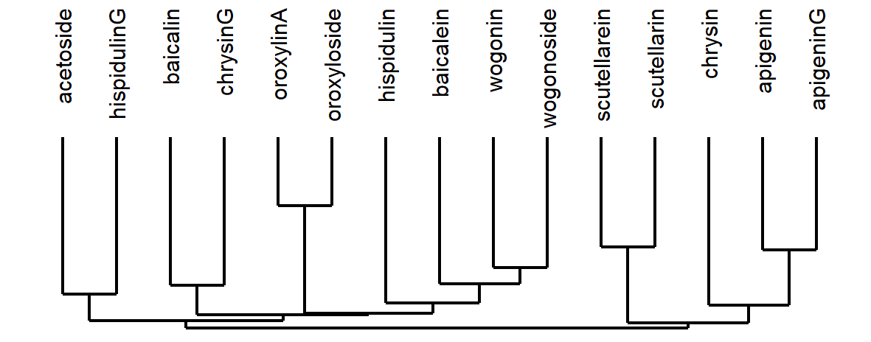
Figure 2. Heatmap of overall flavonoid concentrations measured with High Performance Liquid Chromatography (HPLC) of … species of Scutellaria. Ordering of species and flavonoids was determined by hierarchical clustering based on flavonoid concentration, as illustrated by the dendrogram to the right of and below the heatmap. Colored circles next to species names indicate phylogenetic clade, as shown in Figure 1. An empty circle indicates that the species was not included in the tree from Figure 1. Data for fresh tissue samples is shown at 5000 ppm (5 mg sample / 1 mL solvent). Data for herbarium tissue samples is shown at 500 ppm (0.5 mg sample / 1 mL solvent).

Slide 6
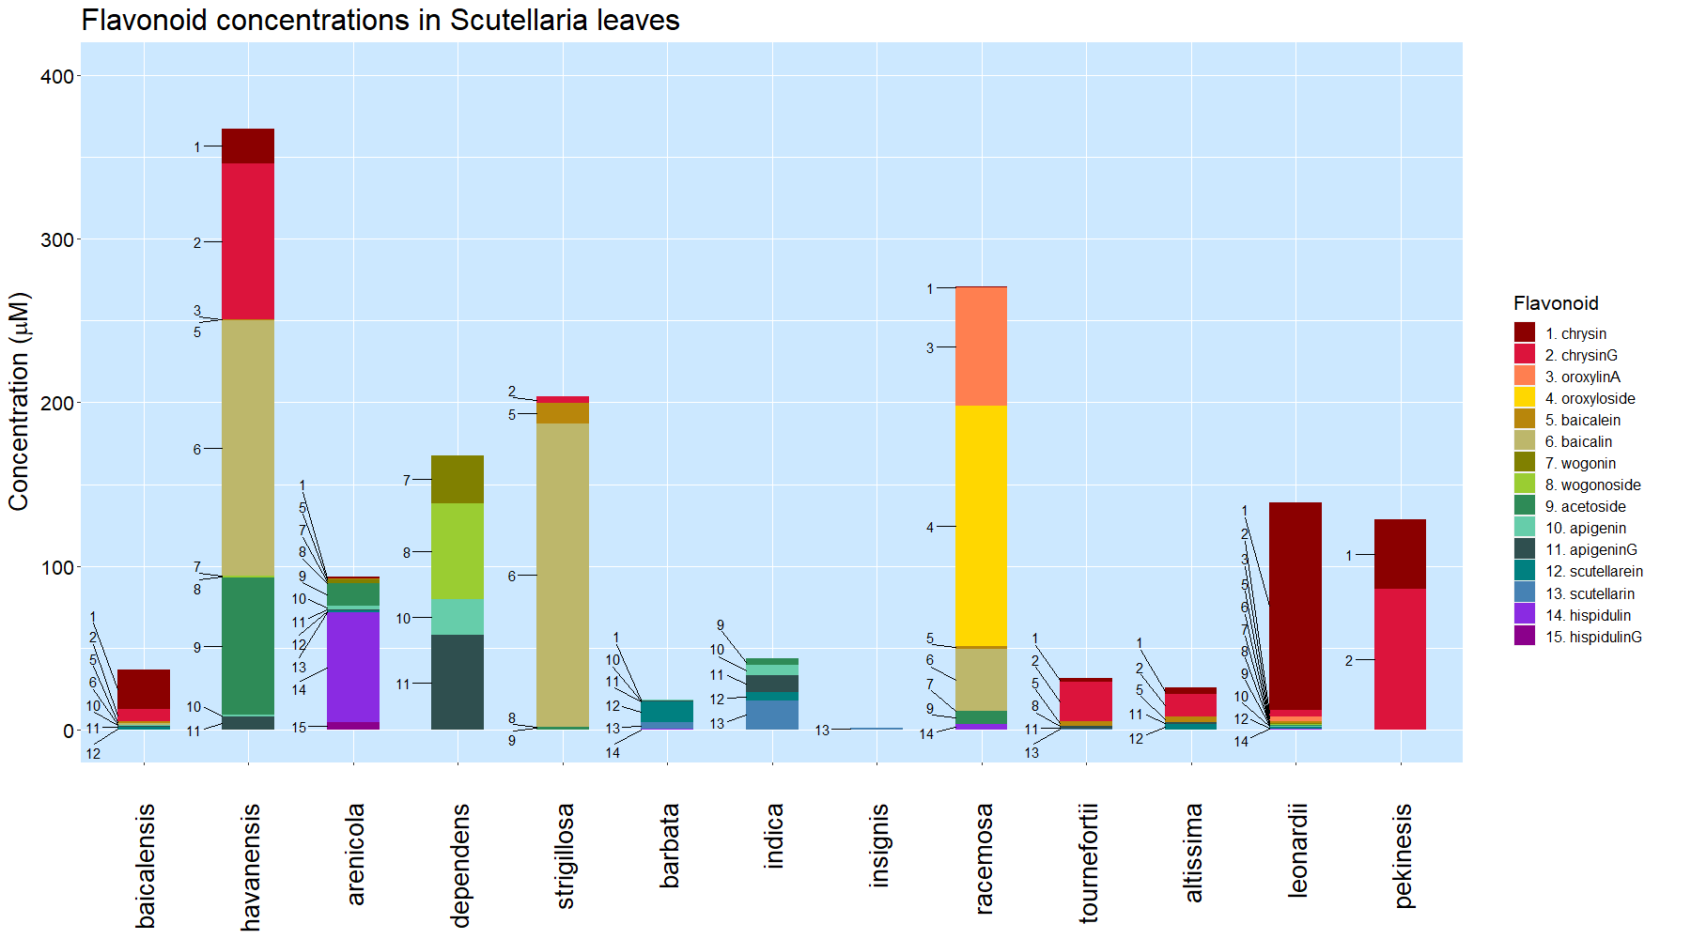
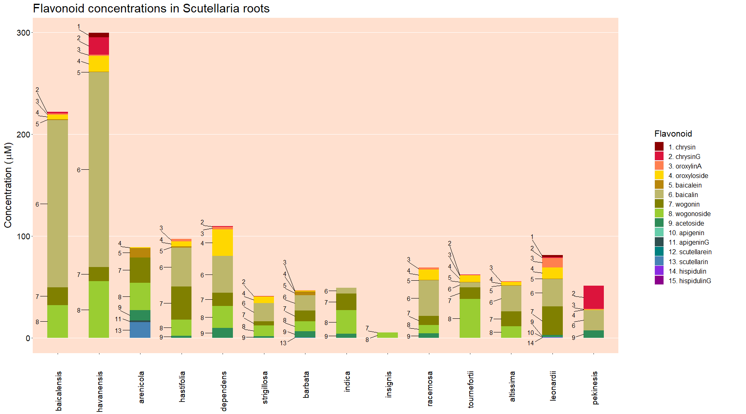
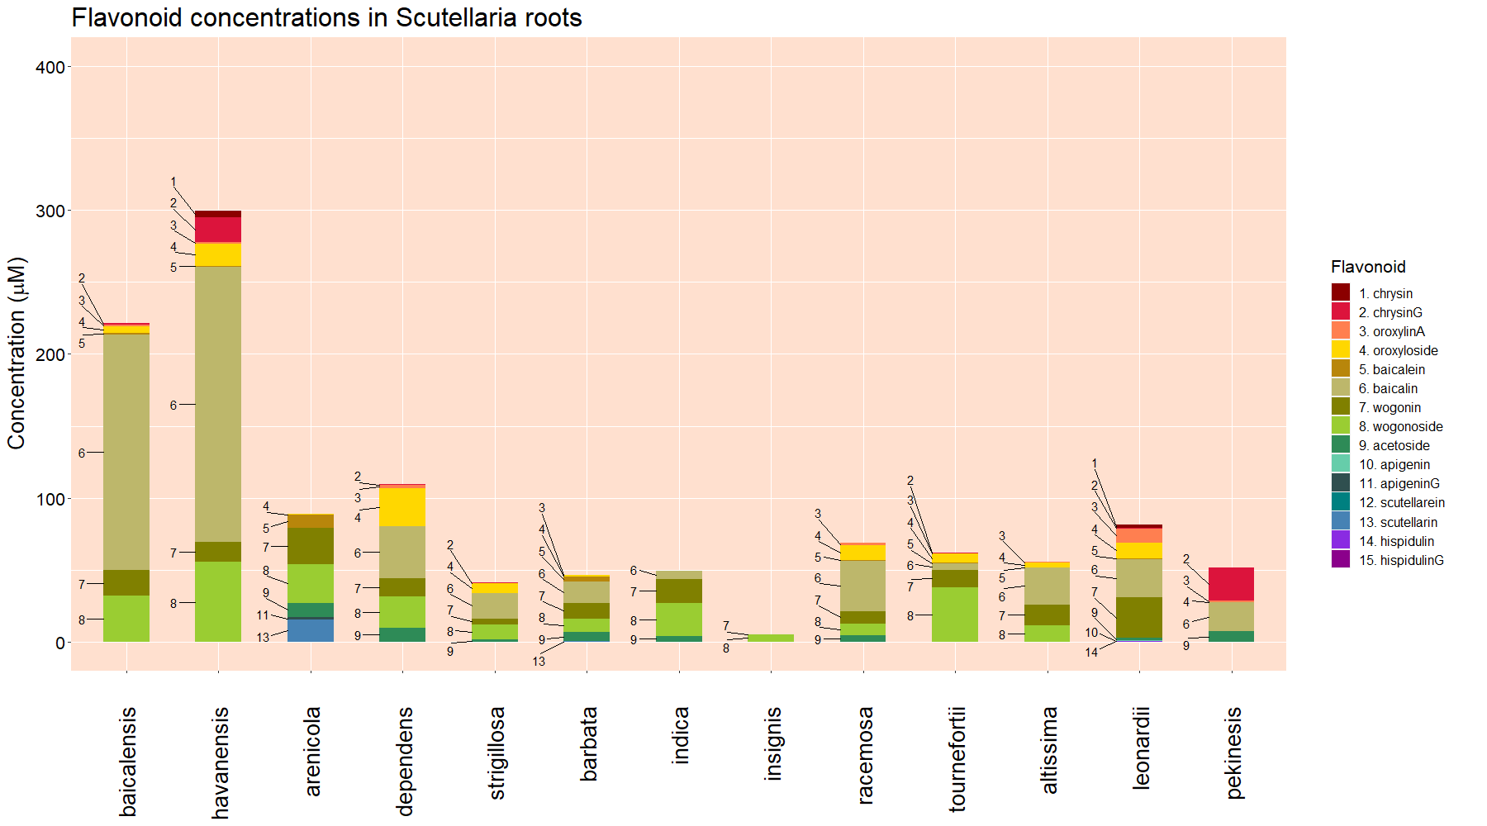
Leaves
Roots
Figure 3. Organ-specific flavonoid data collected from 14 Scutellaria species via High Performance Liquid Chromatography (HPLC). Species are ordered based on phylogenetic relationship determine from chloroplast genome data, shown in Figure 1. Colored circles next to species names indicate phylogenetic clade, as shown in Figure 1. An empty circle indicates that the species was not included in the tree from Figure 1. Flavonoids are ordered based on proposed flavonoid pathway for S. baicalensis.

Slide 7
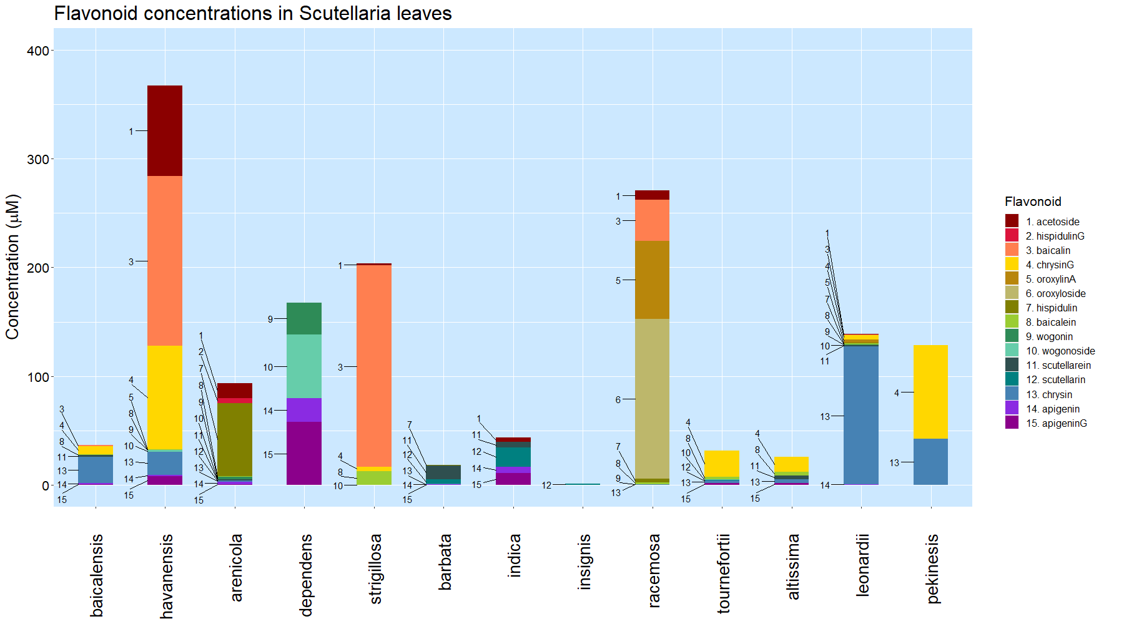
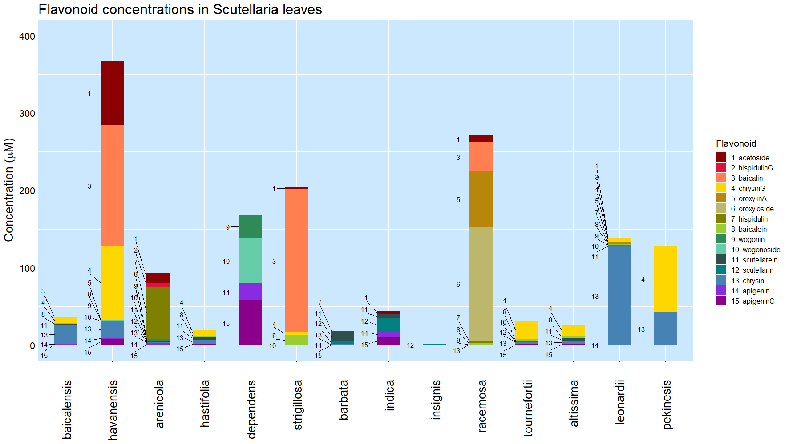
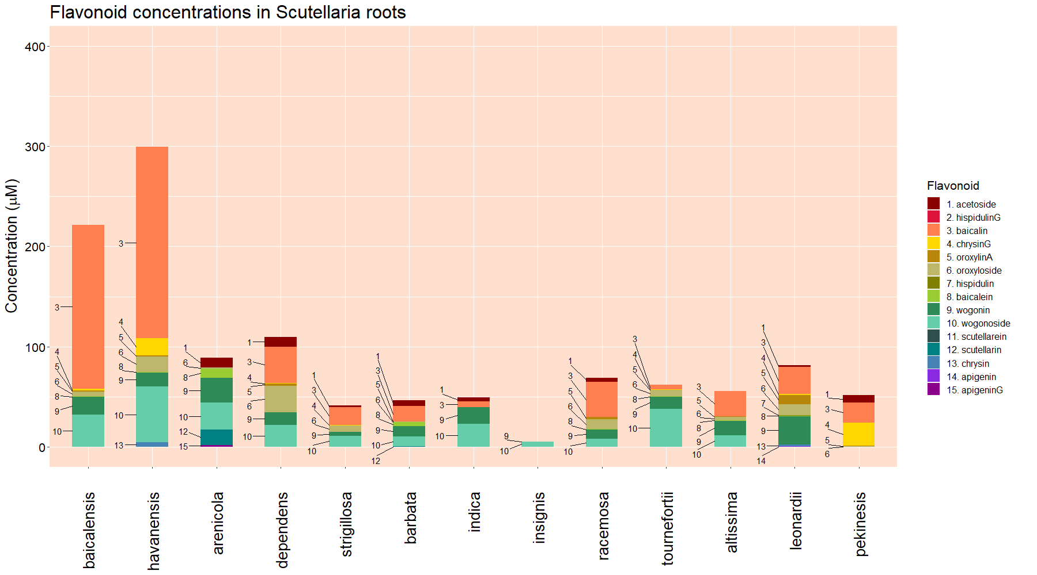
Leaves
Roots
Figure 3. Organ-specific flavonoid data collected from 14 Scutellaria species via High Performance Liquid Chromatography (HPLC). Species are ordered based on phylogenetic relationship determine from chloroplast genome data, shown in Figure 1. Colored circles next to species names indicate phylogenetic clade, as shown in Figure 1. An empty circle indicates that the species was not included in the tree from Figure 1. Flavonoids are ordered based on hierarchical clustering determined previously, illustrated in Figure 2.

Slide 8
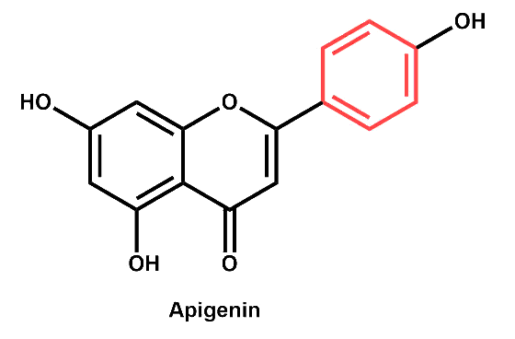
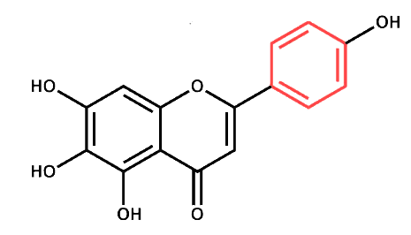
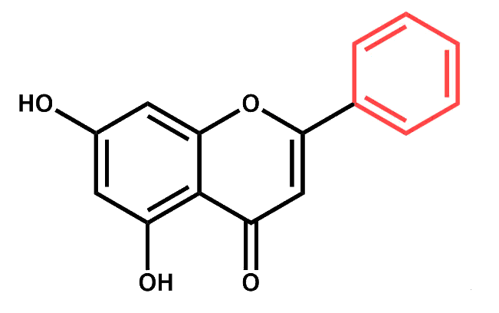
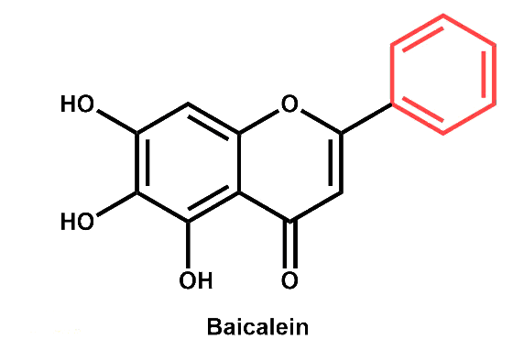
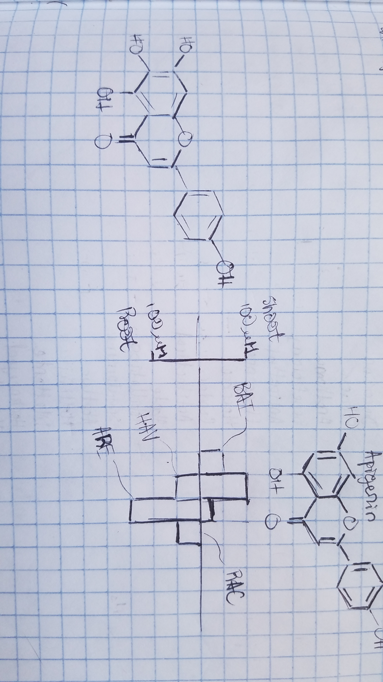
Published
Proposed to occur in shoots
Proposed to occur in roots
4-coumarate
Apigenin
Scutellarein
Phenylalanine
Cinnamic acid
Cinnamoyl-CoA
Chrysin
Baicalein
Figure 4. Proposed

Slide 9
Table 1. Genome sizes as estimated by flow cytometry. Cell colors indicate phylogenetic clade, as shown in Figure 1.
Species | Estimated genome size (Gbp)
 | Measured in this study | Published previously
S. baicalensis | 0.54
S. havanensis | 0.37
S. arenicola | 0.85
S. dependens | 0.44
S. strigillosa | n.d. | 0.39 (Lee & Kim, 2017)
S. barbata | 0.52
S. indica var. coccinea | n.d. | 0.37 (Lee & Kim, 2017)
S. insignis | n.d. | 0.47 (Lee & Kim, 2017)
S. racemosa | 0.44
S. tournefortii | 0.39
S. altissima | 0.39
S. leonardii | 0.50
S. pekenensis | 0.38

